Slide 1
The Statement of Cash Flows (SCH)
Purpose: Provide information about the cash inflows (receipts) and cash outflows (payments) during a period. Explain the changes in cash
SCH provide answers to the following questions
What was our cash sources?
What was our cash consumption?
Explain the change in cash balance
SCF consists of three sections:
Operating activities: Convert net income into “cash net income”.
Investing activities: explain the changes in your investments from a cash flow perspective (purchases and sales of PPE + Investments). LT assets.
Financing activities: explain how the company financed itself form cash flow perspective (company own stocks and bonds)
Cash flows from operating activities $XXX
Cash flows from investing activities XXX
Cash flows from financing activities XXX
Net increase (decrease) in cash XXX
Cash at beginning of year XXX
Cash at end of year $XXX
Student or CPA Candidate?
www.farhatlectures.com

Slide 2
Operating Activities
Operating Activities
Cash: +
Received from Customers
Dividend Revenue
Interest Revenue
Rent Revenue
Cash: -
Cost of goods sold
Salaries
Taxes
Operating expenses
Investing Activities
Cash
Investing Activities
Cash: +
Sales of PPE
Sale of Investment:
Stocks and Bonds
Collecting loans
Cash: -
Purchase of PPE
Purchase of Investment:
Stocks and Bonds
Lending Money
Financing Activities
Financing Activities
Cash: +
Issuance of Stock
Issuance of Bonds
Borrowing Money
Cash: -
Stock acquisition: Treasury Stocks
Dividend payment
redemption of Bonds/debt
Student or CPA Candidate?
www.farhatlectures.com

Slide 3
What is needed?
Comparative balance sheets
Current income statement
Additional Information about transactions.
On January 1, 20X5 Adam INC, consulting Co. started it operation. The company. issued 60,000 shares of $1 par value common stock for $60,000 cash. The company incurred operating expenses such a rent, utilities, taxes, payroll etc. In June 20X5, the company purchased land for $15,000.
Adam Inc.
Income Statement
For the Year Ended December 31, 2020
 | Dec. 31, 20X5 | Jan. 1, 20X5 | Increase/Decrease
Assets
Cash | 41,000 | $-0- | $41,000 Increase
Accounts receivable | 61,000 | -0- | 61,000 Increase
Land | 15,000 | -0- | 15,000 Increase
Total | $117,000 | $-0-
Liabilities and Stockholders' Equity
Accounts payable | $12,000 | $-0- | 12,000 Increase
Common stock | 60,000 | -0- | 60,000 Increase
Retained earnings | 45,000 | -0- | 45,000 Increase
Total | $117,000 | $-0-
Revenues | $192,000
Operating expenses | 120,000
Income before income tax | 72,000
Income tax | 13,000
Net income | $ 59,000
The company paid dividend from the profit.
Student or CPA Candidate?
www.farhatlectures.com

Slide 4
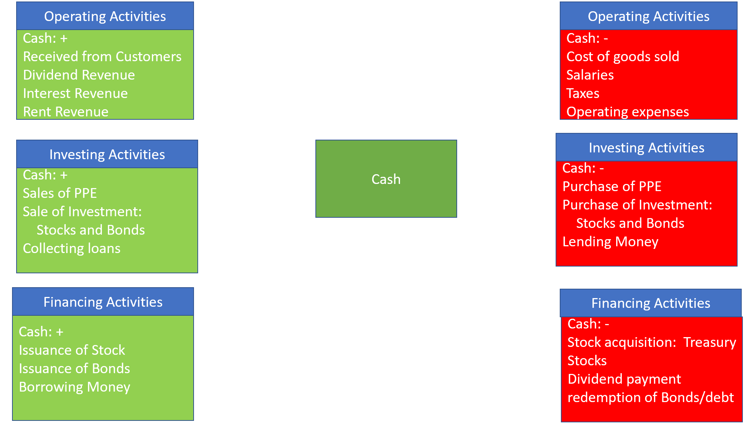
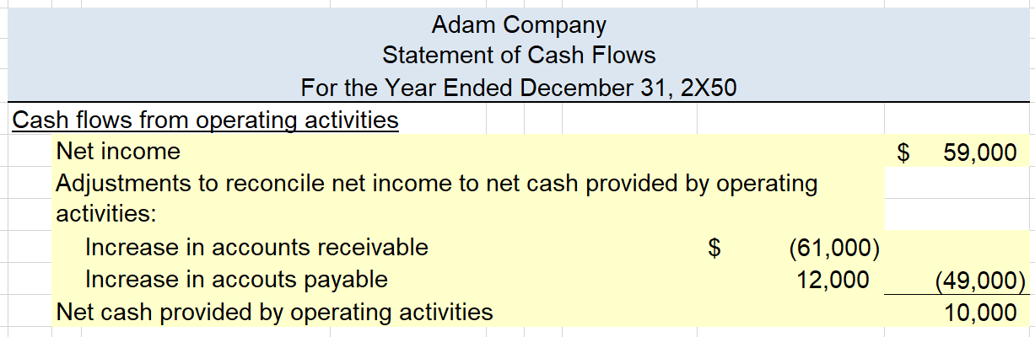
 | Dec. 31, 20X5 | Jan. 1, 20X5 | Increase/Decrease
Assets
Cash | 41,000 | $-0- | $41,000 Increase
Accounts receivable | 61,000 | -0- | 61,000 Increase
Land | 15,000 | -0- | 15,000 Increase
Total | $117,000 | $-0-
Liabilities and Stockholders' Equity
Accounts payable | $12,000 | $-0- | 12,000 Increase
Common stock | 60,000 | -0- | 60,000 Increase
Retained earnings | 45,000 | -0- | 45,000 Increase
Total | $117,000 | $-0-
Prepare the operating activities using the indirect method. 5 Steps
Net income
Plus non-cash expenses such as deprecation, bad debt expense
Add any losses
Deduct any gains
Analyze current assets and liabilities
Revenues | $192,000
Operating expenses | 120,000
Income before income tax | 72,000
Income tax | 13,000
Net income | $ 59,000
Student or CPA Candidate?
www.farhatlectures.com
The company paid dividend from the profit.

Slide 5
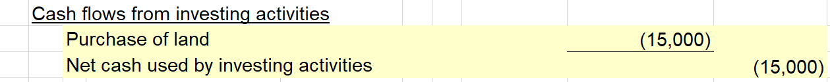
 | Dec. 31, 20X5 | Jan. 1, 20X5 | Increase/Decrease
Assets
Cash | 41,000 | $-0- | $41,000 Increase
Accounts receivable | 61,000 | -0- | 61,000 Increase
Land | 15,000 | -0- | 15,000 Increase
Total | $117,000 | $-0-
Liabilities and Stockholders' Equity
Accounts payable | $12,000 | $-0- | 12,000 Increase
Common stock | 60,000 | -0- | 60,000 Increase
Retained earnings | 45,000 | -0- | 45,000 Increase
Total | $117,000 | $-0-
Revenues | $192,000
Operating expenses | 120,000
Income before income tax | 72,000
Income tax | 13,000
Net income | $ 59,000
Student or CPA Candidate?
www.farhatlectures.com
The company paid dividend from the profit.

Slide 6
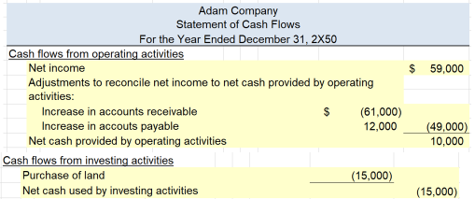
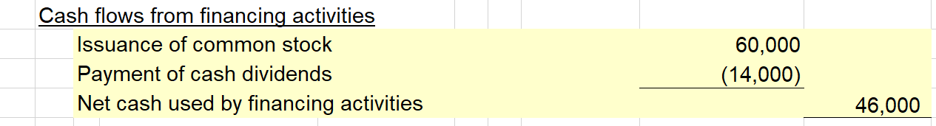
 | Dec. 31, 20X5 | Jan. 1, 20X5 | Increase/Decrease
Assets
Cash | 41,000 | $-0- | $41,000 Increase
Accounts receivable | 61,000 | -0- | 61,000 Increase
Land | 15,000 | -0- | 15,000 Increase
Total | $117,000 | $-0-
Liabilities and Stockholders' Equity
Accounts payable | $12,000 | $-0- | 12,000 Increase
Common stock | 60,000 | -0- | 60,000 Increase
Retained earnings | 45,000 | -0- | 45,000 Increase
Total | $117,000 | $-0-
Revenues | $192,000
Operating expenses | 120,000
Income before income tax | 72,000
Income tax | 13,000
Net income | $ 59,000
The company paid dividend from the profit.
Student or CPA Candidate?
www.farhatlectures.com

