Slide 1
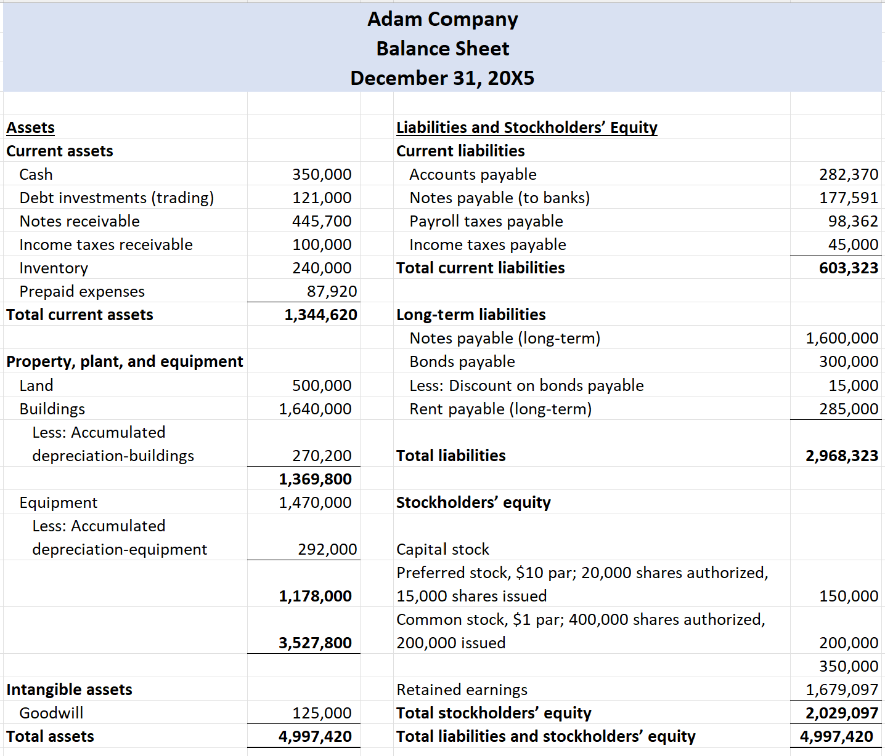

Lectures + MCQs @ farhatlectures.com ➔ Free Trial

Slide 2
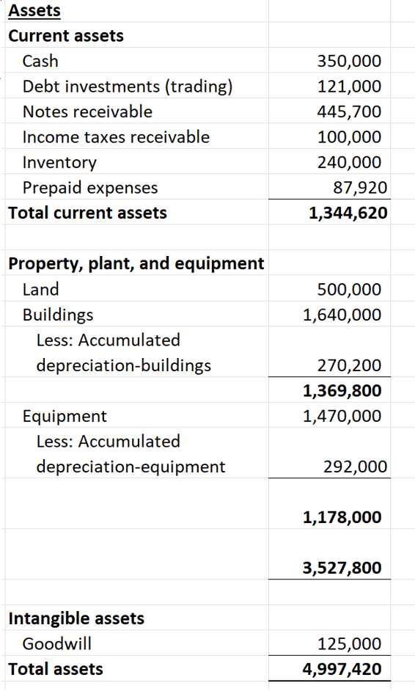
Assets
Assets are everything a company owns that has value. These resources can help the company make money in the future. Assets fall into two main groups:
Current assets: Expected to turn into cash or get used up within a year.
  Cash and cash equivalents
  Accounts receivable (customers’ unpaid bills)
  Inventory (goods ready to sell)
  Prepaid expenses (like insurance paid in advance)
Non-current assets: Used for more than a year.
  Property, plant, and equipment (like land, buildings, and machinery)
  Long-term investments
  Intangible assets (patents, trademarks, goodwill)
  Other assets (anything that doesn’t fit above)
Some companies add an “other assets” section for unusual items that don’t fit neatly elsewhere.
Lectures + MCQs @ farhatlectures.com ➔ Free Trial

Slide 3
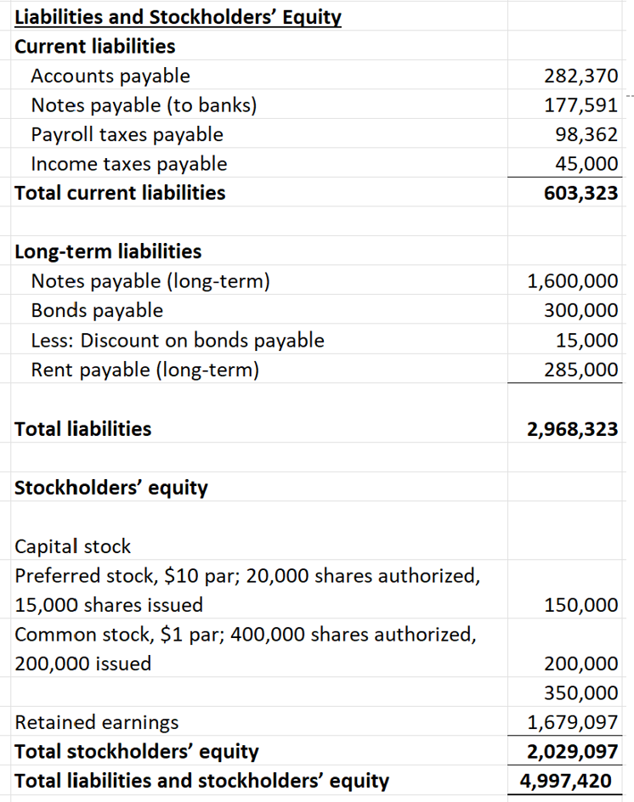
Liabilities
Liabilities are what the company owes to others. Think of these as debts or obligations arising from borrowing or previous transactions. Like assets, liabilities are split:
Current liabilities: Due within a year.
  Accounts payable (bills to suppliers)
  Accrued liabilities (wages, taxes owed)
  Short-term loans
Long-term liabilities: Due after one year.
  Long-term loans and bonds
  Lease obligations
  Deferred tax liabilities
Liabilities show up as a claim against assets—they come first in line before any profits go to owners.
Lectures + MCQs @ farhatlectures.com ➔ Free Trial

Slide 4
Stockholders’ Equity
Stockholders’ equity (or just equity) is the difference between what the company owns and what it owes. It’s the owners’ share in the business.
The main parts of equity:
Common stock and additional paid-in capital: Money that investors have put into the company.
Retained earnings: Profits the company has made over time, minus any dividends paid out.
Other possible equity items exist but these two are at the core, especially for exam and practical purposes.
Equity = Assets – Liabilities. It tells you what would be left for owners if the company paid all its debts today.
Lectures + MCQs @ farhatlectures.com ➔ Free Trial

Slide 5

Uses and Importance of the Balance Sheet
Why is the balance sheet so valuable? It does more than list amounts—it tells you about company stability, risk, and ability to grow.
Capital Structure Analysis
The capital structure reveals how a company finances its assets—using debt, equity, or a mix of both.
This matters because debt requires regular interest payments, raising the risk level.
Equity financing, on the other hand, doesn’t force cash payments unless dividends are declared.
Lectures + MCQs @ farhatlectures.com ➔ Free Trial

Slide 6
Capital structure
This company has $5 million in assets, with $2.97 million in liabilities.
Debt-to-asset ratio: $2.97 million ÷ $5 million = 59%
This means 59% of company assets are financed by borrowing. The higher this percentage, the riskier the company.
More debt leads to more required cash outflows and less flexibility.
On the flip side, higher equity means lower required payouts and greater ability to weather tough times.
Lectures + MCQs @ farhatlectures.com ➔ Free Trial

Slide 7
Liquidity Analysis
Liquidity is about the company’s ability to turn assets into cash fast, mainly to cover short-term debts.
Creditors, suppliers, and investors care about liquidity because it signals whether the company can meet its bills.
Common liquidity indicators include:
Current ratio (current assets ÷ current liabilities)
Quick ratio (liquid assets ÷ current liabilities)
These ratios provide a quick look at whether the company is in a good spot to handle short-term needs.
Lectures + MCQs @ farhatlectures.com ➔ Free Trial

Slide 8
Solvency Analysis
While liquidity focuses on the short term, solvency is about long-term survival.
Does the company have the resources to pay off its long-term debts?
A business with solid solvency is less likely to go under if times get tough. Ratio analysis, such as the debt-to-equity ratio, gives you a sense of long-term financial health.
Lectures + MCQs @ farhatlectures.com ➔ Free Trial

Slide 9

Financial Flexibility
Financial flexibility blends liquidity and solvency.
It signals how well a company can adapt to changes, survive downturns, or jump on opportunities.
If a company has little debt, it has more options when a crisis hits.
  High flexibility means lower risk.
For example, during the 2007-2008 financial crisis, General Motors struggled because of heavy debt and not enough cash, while Ford, with more flexibility, survived.
Flexibility is like having a cushion.
When a good chance comes along, companies with flexible balance sheets can jump on it. Those already loaded with debt, though, may have to pass.
Lectures + MCQs @ farhatlectures.com ➔ Free Trial

Slide 10

Limitations of the Balance Sheet
Despite its value, the balance sheet isn’t perfect.
Use of Historical Cost
Many assets, like land, buildings, and equipment, are listed at historical cost (what the company paid for them). Market values may have changed a lot since then, so these figures might not reflect today’s reality.
There’s a move toward using “fair value” for some items:
  Investments are shown at current market value.
  Accounts receivable use “net realizable value,” reflecting what the company expects to collect.
  Inventory is reported at the lower of cost or market value.
Still, a lot of assets remain on the books at values that may have little meaning for current decision-making.
Lectures + MCQs @ farhatlectures.com ➔ Free Trial

Slide 11
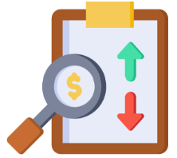
Estimates and Judgments
The balance sheet depends on many estimates and management guesses:
  Allowance for doubtful accounts (unpaid customer bills)
  Warranty liabilities (future repair costs)
  Accumulated depreciation (how quickly assets lose value)
  Every estimate can be off: actual customer payments may differ, products may fail more (or less) than expected, and asset lives may be guessed wrong.
  These estimates create uncertainty and can affect how users view the numbers.
Examples of balance sheet estimates:
  Allowance for doubtful accounts
  Warranty reserve
  Accumulated depreciation
Lectures + MCQs @ farhatlectures.com ➔ Free Trial

Slide 12

Intangible and Soft Assets Not Captured
Not all assets show up on the balance sheet. Some of the most valuable parts of a business are missing:
  A great management team
  Talented employees
  Strong brand reputation
Many would argue Elon Musk is the company’s biggest asset, but you won’t see his value in any financial statement.
The same goes for reputation and company culture.
These intangible assets—sometimes more important than what’s on the books—remain invisible in standard financial reporting.
Lectures + MCQs @ farhatlectures.com ➔ Free Trial

Slide 13
MCQ from farhatlectures.com
Which of the following best defines liquidity?
how much a company uses financial leverage.
how long it takes to refinance short-term debts.
how much cash the company has at a given time.
how easily an asset can be converted to cash without affecting its price.
Lectures + MCQs @ farhatlectures.com ➔ Free Trial

