Slide 1
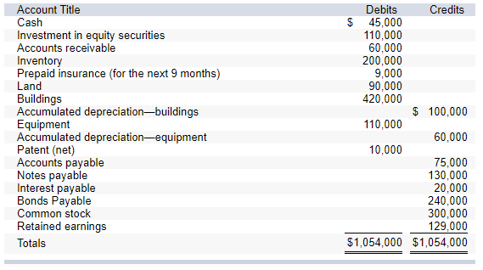
The investment in equity securities account includes an investment in common stock of another corporation of $30,000 which management intends to hold for at least three years. The balance of these investments is intended to be sold in the coming year.
The land account includes land which cost $25,000 that the company has not used and is currently listed for sale.
The cash account includes $15,000 restricted in a fund to pay bonds payable that mature in 2024 and $23,000 restricted in a three-month Treasury bill.
The notes payable account consists of the following:
a $30,000 note due in six months.
a $50,000 note due in six years.
a $50,000 note due in five annual installments of $10,000 each, with the next installment due February 15, 2022.
The $60,000 balance in accounts receivable is net of an allowance for uncollectible accounts of $8,000.
The common stock account represents 100,000 shares of no par value common stock issued and outstanding. The corporation has 500,000 shares authorized.
For more visit:
www.farhatlectures.com

Slide 2
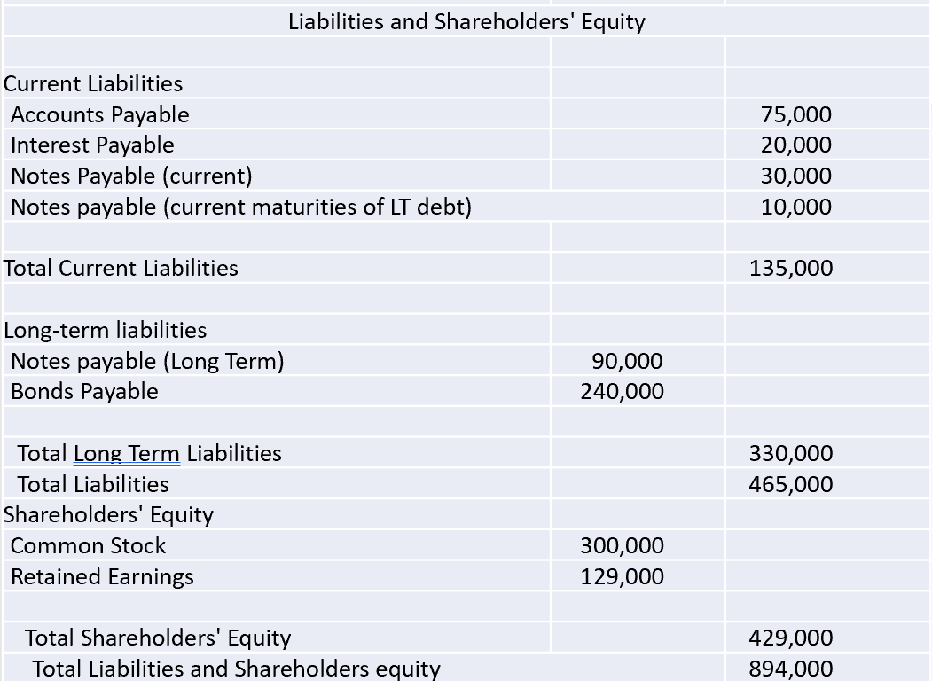
Adam CORPORATION
Balance Sheet
At December 31, 2021
Assets
Current assets:
Cash and cash equivalents |  | 30,000
Investment in equity securities |  | 80,000
Accounts receivable | 68,000
Less: Allowance for uncollectible accounts | (8,000)
Net accounts receivable |  | 60,000
Inventory |  | 200,000
Prepaid insurance |  | 9,000
Total current assets |  | 379,000
Investments:
Investment in equity securities | 30,000
Land held for sale | 25,000
Restricted cash | 15,000
Total investments |  | 70,000
Property, plant, and equipment:
Land | 65,000
Buildings | 420,000
Equipment | 110,000
 | 595,000
Less: Accumulated depreciation-buildings | (100,000)
Less: Accumulated depreciation-equipment | (60,000)
Net property, plant, and equipment |  | 435,000
Intangible assets:
Patent (net) |  | 10,000
Total assets |  | 894,000
For more visit:
www.farhatlectures.com

