Slide 1
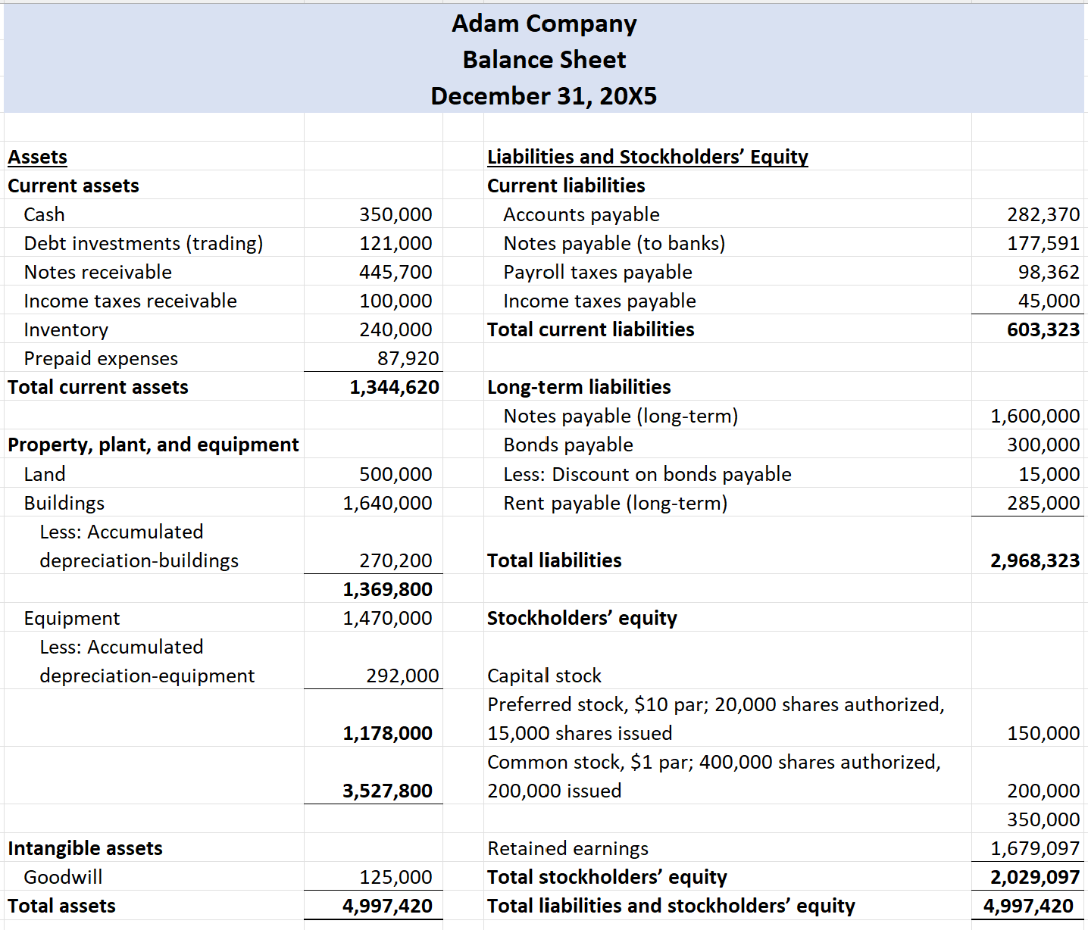

Lectures + MCQs @ farhatlectures.com ➔ Free Trial

Slide 2
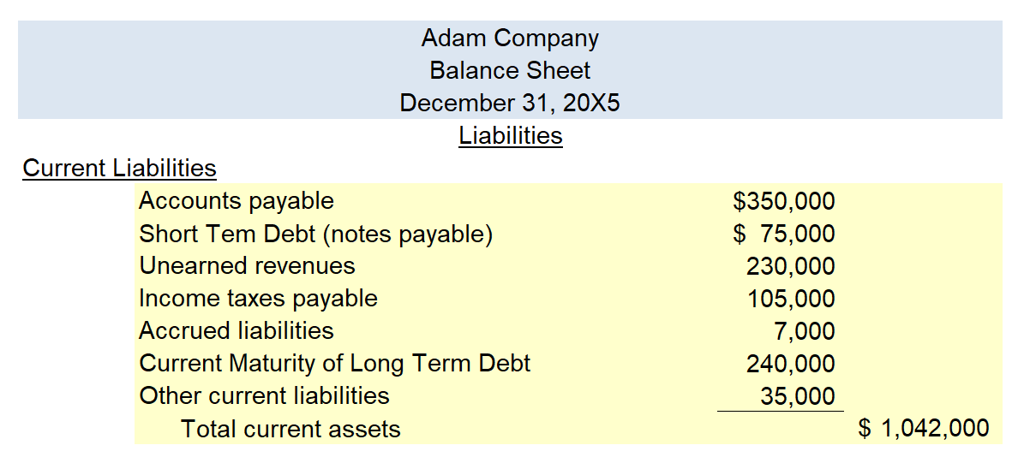
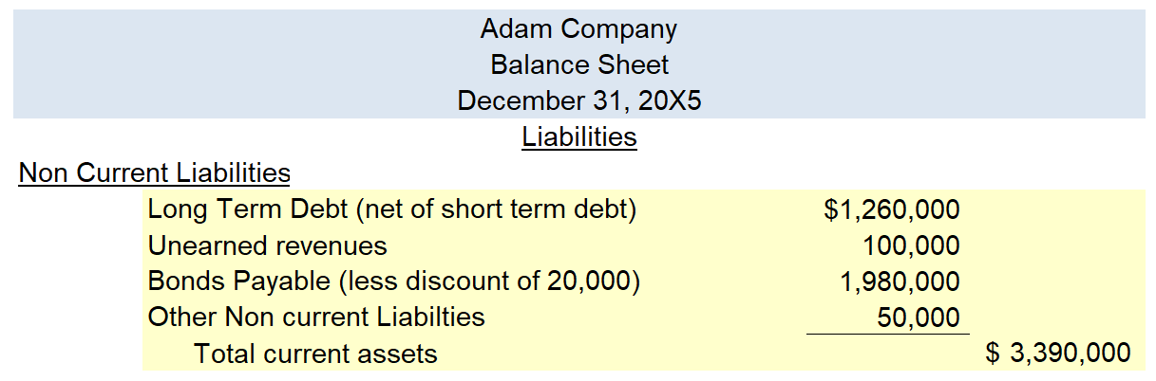
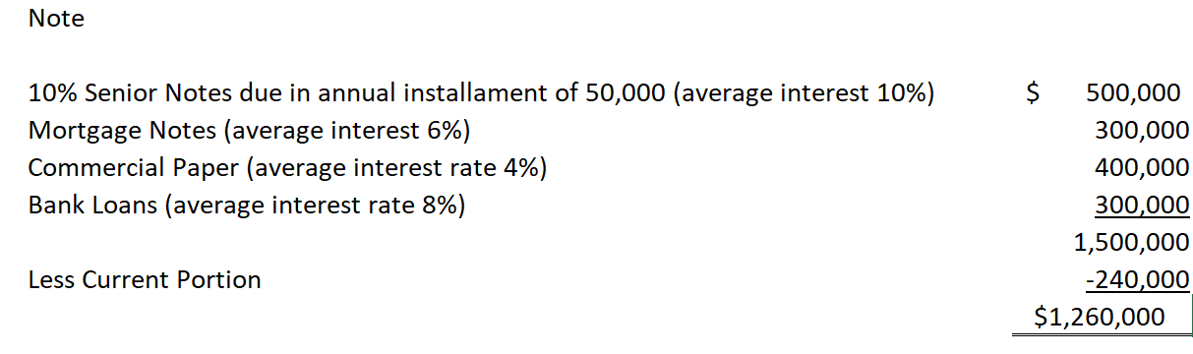
Assets | Liabilities and Owners' Equity
Current assets | Current liabilities
Long-term investments | Long-term debt
Property, plant, and equipment | Stockholders’ equity
Intangible assets
Other assets
Liabilities expected to be paid off within one year or operating cycle whichever is longer through the use of current assets or creation of other current liabilities
Lectures + MCQs @ farhatlectures.com ➔ Free Trial

Slide 3
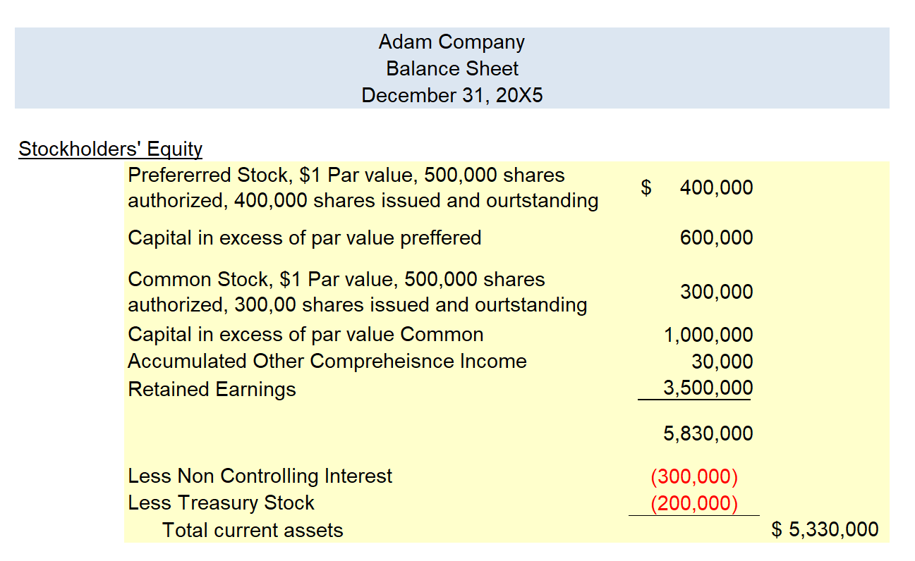
Assets | Liabilities and Owners' Equity
Current assets | Current liabilities
Long-term investments | Long-term debt
Property, plant, and equipment | Stockholders’ equity
Intangible assets
Other assets
Lectures + MCQs @ farhatlectures.com ➔ Free Trial

Slide 4
MCQ from Farhatlectures.com
​All of the following accounts are classified as current liabilities except for:
Rent payments received in advance
Taxes payable
Insurance premiums paid in advance
Accrued payroll
Lectures + MCQs @ farhatlectures.com ➔ Free Trial

