Slide 1
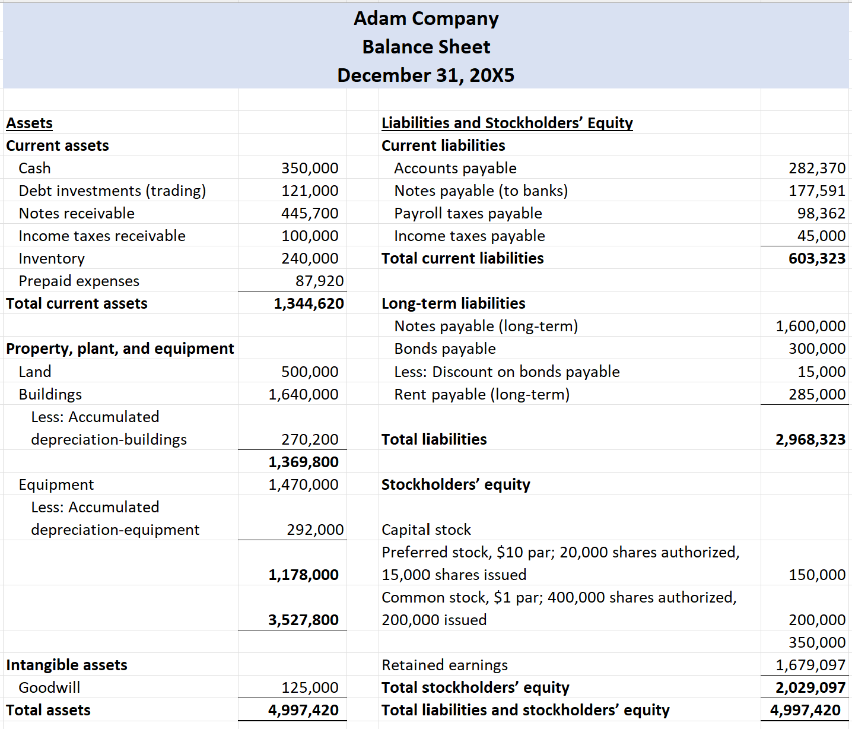

Lectures + MCQs @ farhatlectures.com ➔ Free Trial

Slide 2
Balance sheet or Statement of Financial Position
Assets | Liabilities and Owners' Equity
Current assets | Current liabilities
Long-term investments | Long-term debt
Property, plant, and equipment | Stockholders’ equity
Intangible assets
Other assets
Lectures + MCQs @ farhatlectures.com ➔ Free Trial

Slide 3
Assets | Liabilities and Owners' Equity
Current assets | Current liabilities
Long-term investments | Long-term debt
Property, plant, and equipment | Stockholders’ equity
Intangible assets
Other assets
Adam Company
Balance Sheet
December 31, 20X5
Assets
Current assets
 | Cash and Cash Equivalent Note 5 |  |  |  |  | $350,000
 | Restricted Cash (note 8) |  |  |  |  | $ 75,000
 | Debt investments (Note 2) |  |  |  |  | 230,000
 | Account & Notes Receivable (net) Note 7 |  |  |  |  | 105,000
 | Income Taxes Receivable (note 10) |  |  |  |  | 7,000
 | Inventory (note 6) |  |  |  |  | 240,000
 | Prepaid expenses |  |  |  |  | 35,000
 | Total current assets |  |  |  |  |  | $1,042,000
Current Assets: Assets a company expects to:
convert into cash,
sell, or
consume
either in one year or in the operating cycle, whichever is longer.
Item | Basis of Valuation
Cash and cash equivalents | Fair value
Short-term investments | Generally, fair value
Receivables | Net Realizable Value
Inventories | Lower-of-cost-or-net realizable value/market
Prepaid expenses | Cost
Supplies | Cost
Lectures + MCQs @ farhatlectures.com ➔ Free Trial

Slide 4
Adam Company
Balance Sheet
December 31, 20X5
Assets
Current assets
 | Cash and Cash Equivalent (Note 5) |  |  |  |  | $350,000
 | Restricted Cash (note 8) |  |  |  |  | $ 75,000
 | Debt investments (Note 2) |  |  |  |  | 230,000
 | Account & Notes Receivable (net) Note 7 |  |  |  |  | 105,000
 | Income Taxes Receivable (note 10) |  |  |  |  | 7,000
 | Inventory (note 6) |  |  |  |  | 240,000
 | Prepaid expenses |  |  |  |  | 35,000
 | Total current assets |  |  |  |  |  | $1,042,000
Note 5:
We classify all highly liquid instruments with an original maturity of three months or less as cash equivalents.
Note 8:
Restricted Cash consist of Certificate of deposits (CD) restricted as collateral for debt services at Bank of America with interest rate ranging from 8 to 10%.
Lectures + MCQs @ farhatlectures.com ➔ Free Trial

Slide 5
Adam Company
Balance Sheet
December 31, 20X5
Assets
Current assets
 | Cash and Cash Equivalent (Note 5) |  |  |  |  | $350,000
 | Restricted Cash (note 8) |  |  |  |  | $ 75,000
 | Debt investments (Note 2) |  |  |  |  | 230,000
 | Account & Notes Receivable (net) Note 7 |  |  |  |  | 105,000
 | Income Taxes Receivable (note 10) |  |  |  |  | 7,000
 | Inventory (note 6) |  |  |  |  | 240,000
 | Prepaid expenses |  |  |  |  | 35,000
 | Total current assets |  |  |  |  |  | $1,042,000
Note 2:
Debt investment are reported ay fair value. The following schedule summarize the estimated value.
Investment | Fair Value
Corporate Notes | 100,000
Municipal Bonds | 75,000
U.S. Government Securities | 55,000
Total | 230,000
More about investment in future chapters.
Lectures + MCQs @ farhatlectures.com ➔ Free Trial

Slide 6
Adam Company
Balance Sheet
December 31, 20X5
Assets
Current assets
 | Cash and Cash Equivalent (Note 5) |  |  |  |  | $350,000
 | Restricted Cash (note 8) |  |  |  |  | $ 75,000
 | Debt investments (Note 2) |  |  |  |  | 230,000
 | Account & Notes Receivable (net) Note 7 |  |  |  |  | 105,000
 | Income Taxes Receivable (note 10) |  |  |  |  | 7,000
 | Inventory (note 6) |  |  |  |  | 240,000
 | Prepaid expenses |  |  |  |  | 35,000
 | Total current assets |  |  |  |  |  | $1,042,000
Note 7:
Included in “Accounts receivable, net and other” on our consolidated balance sheets are amounts primarily related to customer. We estimate losses on receivables based on known troubled accounts and historical experience of losses incurred. Receivables are considered impaired and written-off when it is probable that all contractual payments due will not be collected in accordance with the terms of the agreement. The allowance for doubtful accounts was etc….
Note 10:
As a result of a settled net operating losses (NOL) dispute in our favor (with the Internal Revenue Service (IRS), we except a refund of 7,000 from the federal government.
Lectures + MCQs @ farhatlectures.com ➔ Free Trial

Slide 7
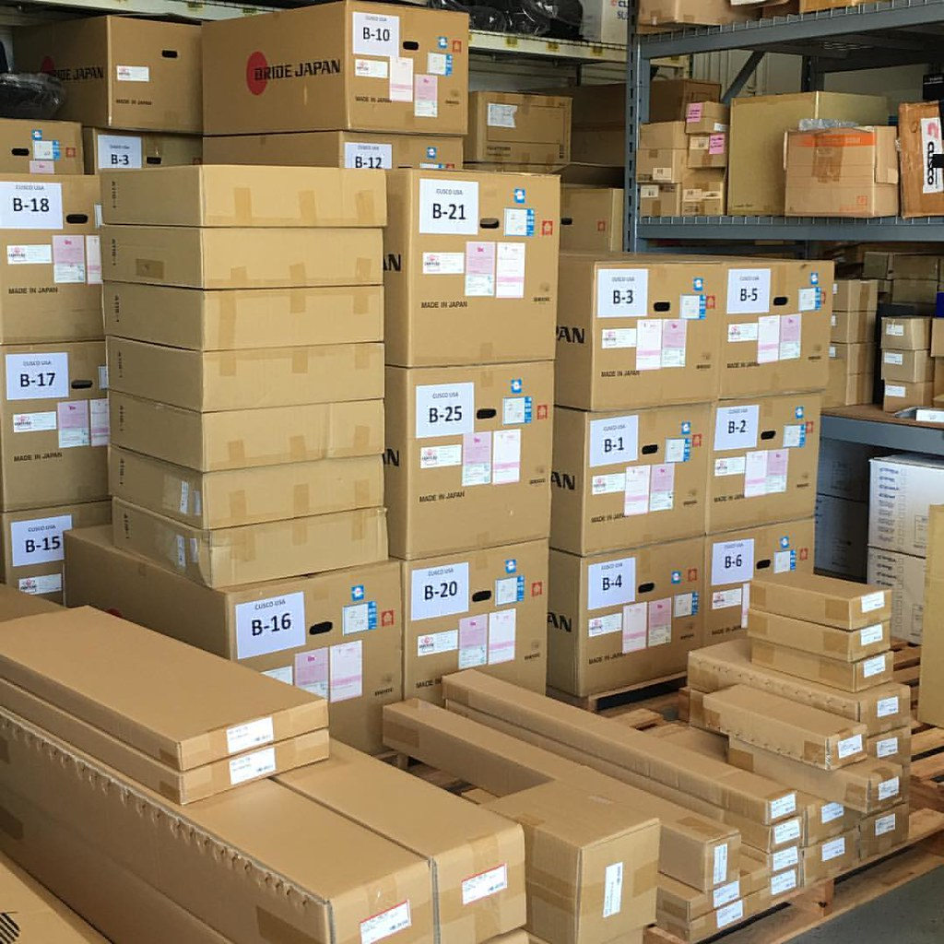
Adam Company
Balance Sheet
December 31, 20X5
Assets
Current assets
 | Cash and Cash Equivalent (Note 5) |  |  |  |  | $350,000
 | Restricted Cash (note 8) |  |  |  |  | $ 75,000
 | Debt investments (Note 2) |  |  |  |  | 230,000
 | Account & Notes Receivable (net) Note 7 |  |  |  |  | 105,000
 | Income Taxes Receivable (note 10) |  |  |  |  | 7,000
 | Inventory (note 6) |  |  |  |  | 240,000
 | Prepaid expenses |  |  |  |  | 35,000
 | Total current assets |  |  |  |  |  | $1,042,000
.
Note 6:
Inventories, consisting of products available for sale, are primarily accounted for using the first-in, first-out method, and are valued at the lower of cost and net realizable value. This valuation requires us to make judgments, based on currently available information, about the likely method of disposition, such as through sales to individual customers, returns to product vendors, or liquidations, and expected recoverable values of each disposition category.
Lectures + MCQs @ farhatlectures.com ➔ Free Trial

Slide 8
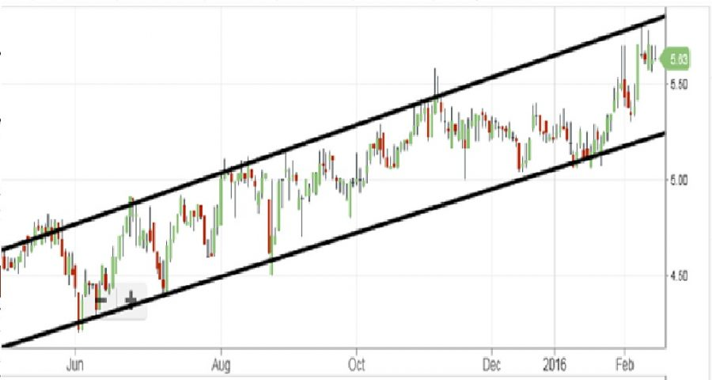
Assets | Liabilities and Owners' Equity
Current assets | Current liabilities
Long-term investments | Long-term debt
Property, plant, and equipment | Stockholders’ equity
Intangible assets
Other assets
Long-Term Investments: Investment that are held longer than one period.
Stocks (fair value) and bonds (amortized cost or fair value) of other companies. Called Securities
Nonconsolidated subsidiaries or affiliated companies (cost or equity method)
Fixed tangible asset held for speculation (Not operation). Land, Building. (realizable value)
Lectures + MCQs @ farhatlectures.com ➔ Free Trial

Slide 9
Adam Company
Balance Sheet
December 31, 20X5
Assets
Investments (notes 12):
 | Equity Investment |  |  |  |  | $750,000
 | Debt investments |  |  |  |  | $300,000
 | Total current assets |  |  |  |  |  | $1,050,000
Note 12:
Investments in debt securities classified as available-for-sale are carried at fair value with changes in fair value recorded in other comprehensive income. Certain investments will be accounted for using the equity method if the Company has significant influence over the issuing entity.
The Company assesses declines in the fair value of debt securities and equity method investments to determine whether such declines are other-than-temporary. This assessment is made considering all available evidence, including changes in general market conditions, specific industry and individual company data etc..
Student or CPA Candidate?
www.farhatlectures.com

Slide 10
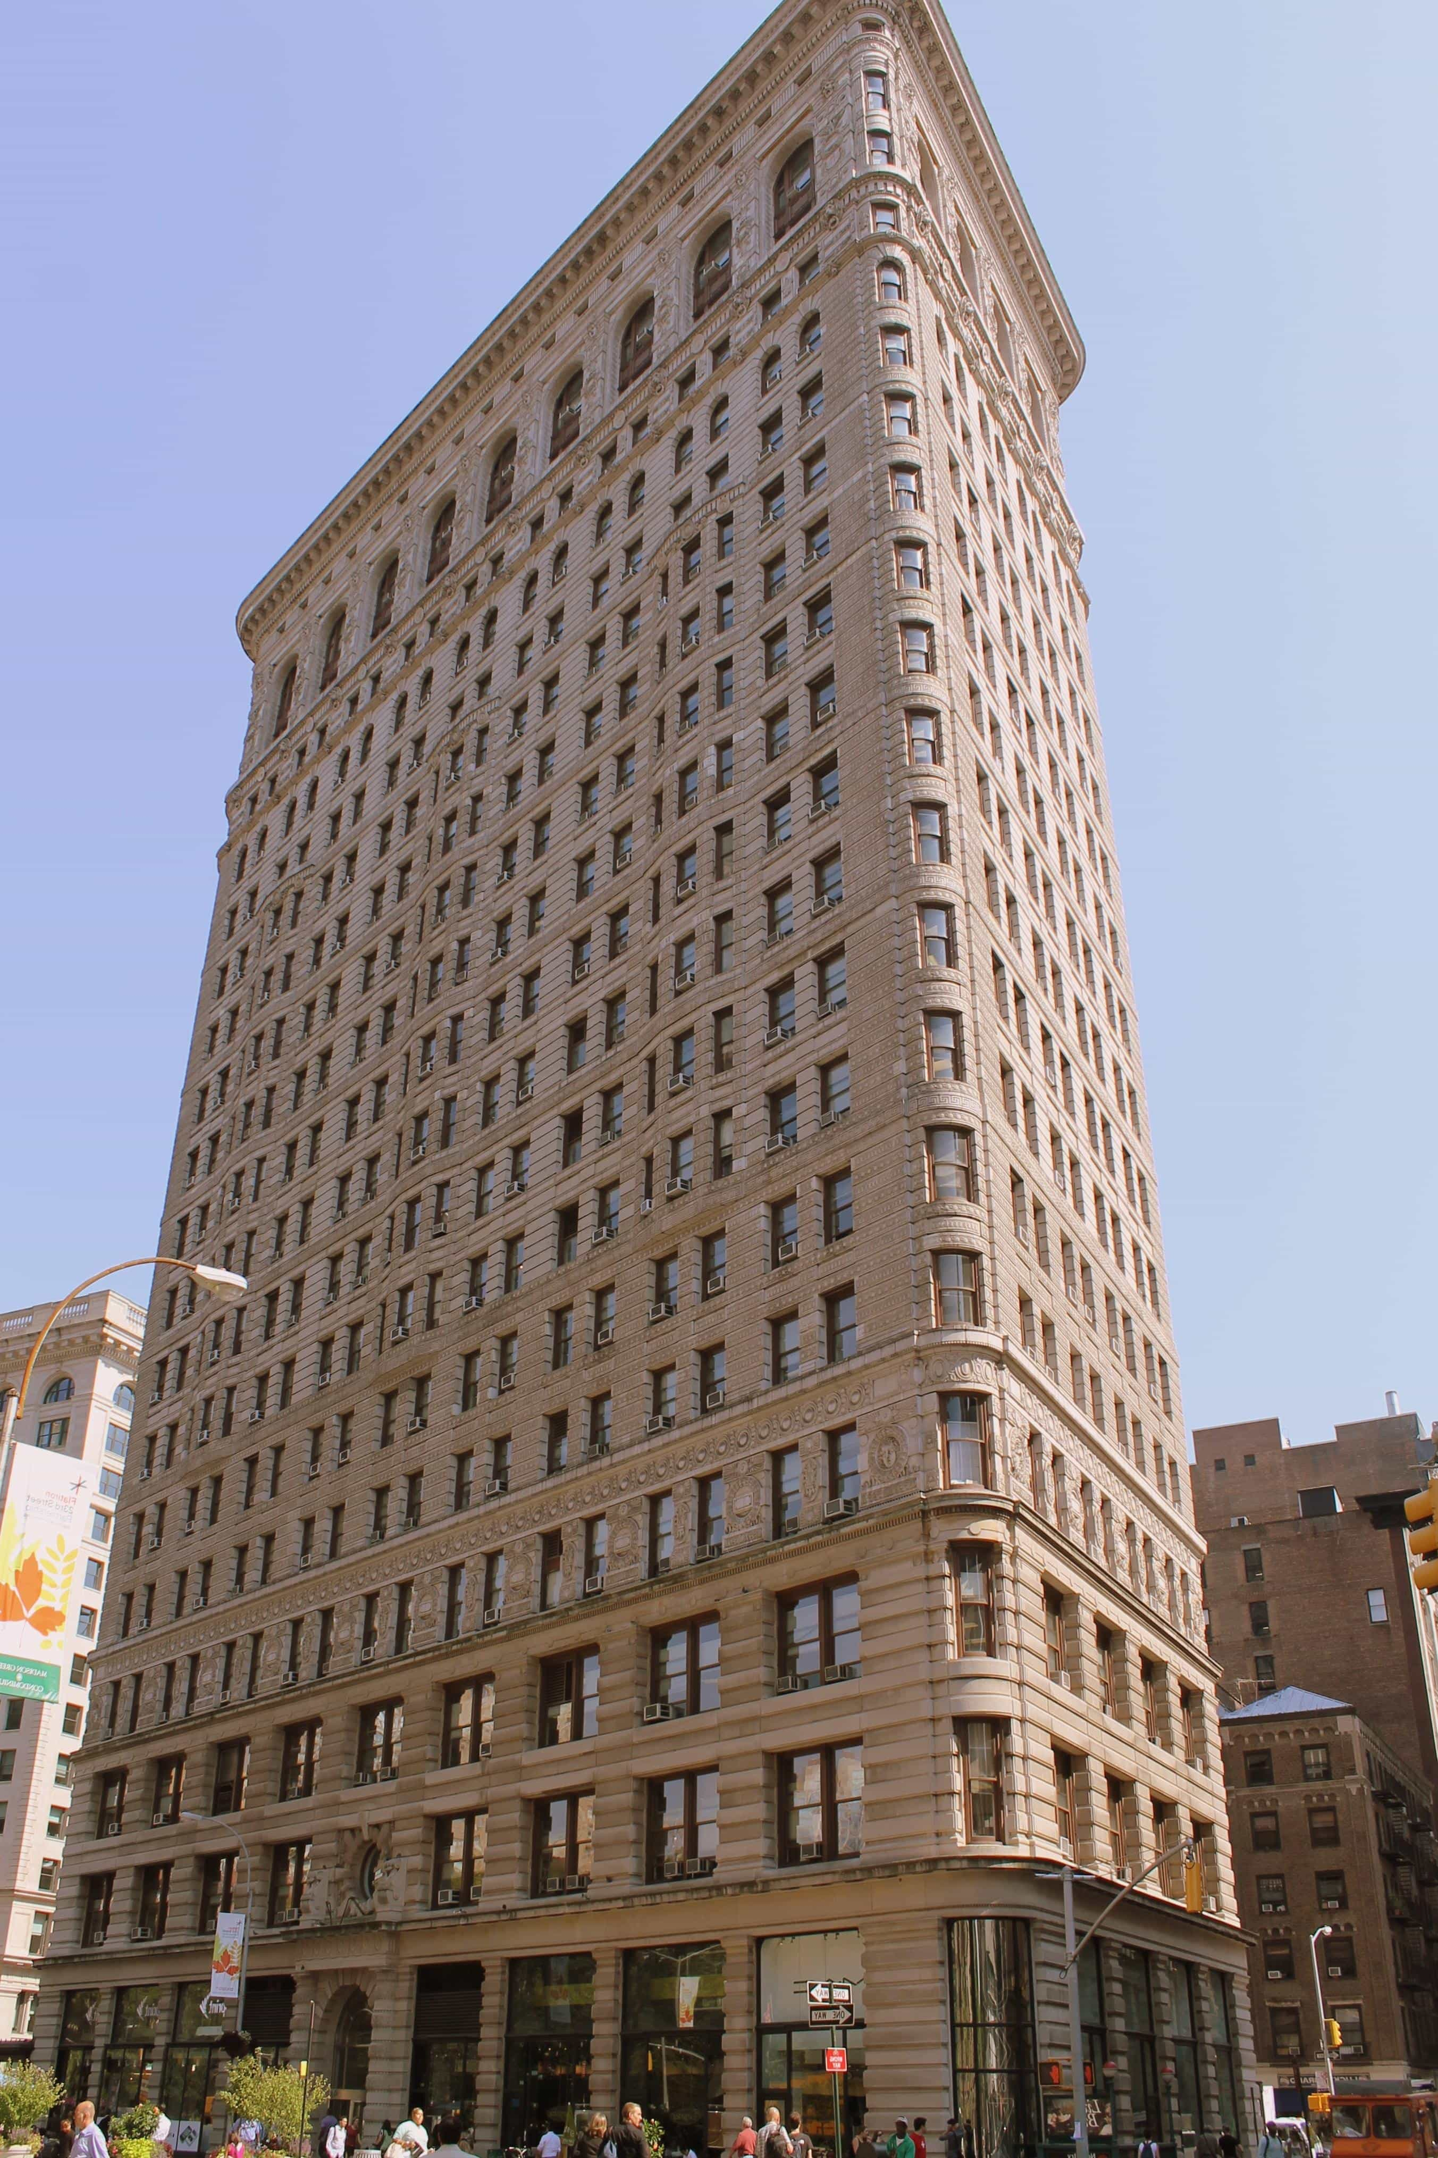
Assets | Liabilities and Owners' Equity
Current assets | Current liabilities
Long-term investments | Long-term debt
Property, plant, and equipment | Stockholders’ equity
Intangible assets
Other assets
Tangible long-live assets used in the regular operation of the business:
Land
Building
Machinery
Furniture
Tools
Natural resources or wasting resources
Reported at book value or carrying value (net of accumulated depreciation)
Lectures + MCQs @ farhatlectures.com ➔ Free Trial

Slide 11
Adam Company
Balance Sheet
December 31, 20X5
Assets
Property Plant and Equipment
 | Land |  |  |  |  |  | $ 350,000
 | Building |  |  |  |  |  | $ 75,000
 | Machinery and Equipment |  |  |  |  |  | 230,000
 |  |  |  |  |  |  | 655,000
 | Less Accumulated Depreciatipon |  |  |  |  |  | 120,000
 | Property. Plant and Equipment Net |  |  |  |  |  | 535,000
Note:
Property, plant and equipment are stated at cost less accumulated depreciation. Depreciation is recorded on a straight-line basis, based on the estimated useful lives of the assets (leasehold improvements, one to twenty years; machinery and equipment, one to fifteen years and commences once the assets are ready for their intended use. When certain events or changes in operating conditions occur, useful lives of the assets may be adjusted or an impairment assessment may be performed on the recoverability of the carrying value.
Lectures + MCQs @ farhatlectures.com ➔ Free Trial

Slide 12
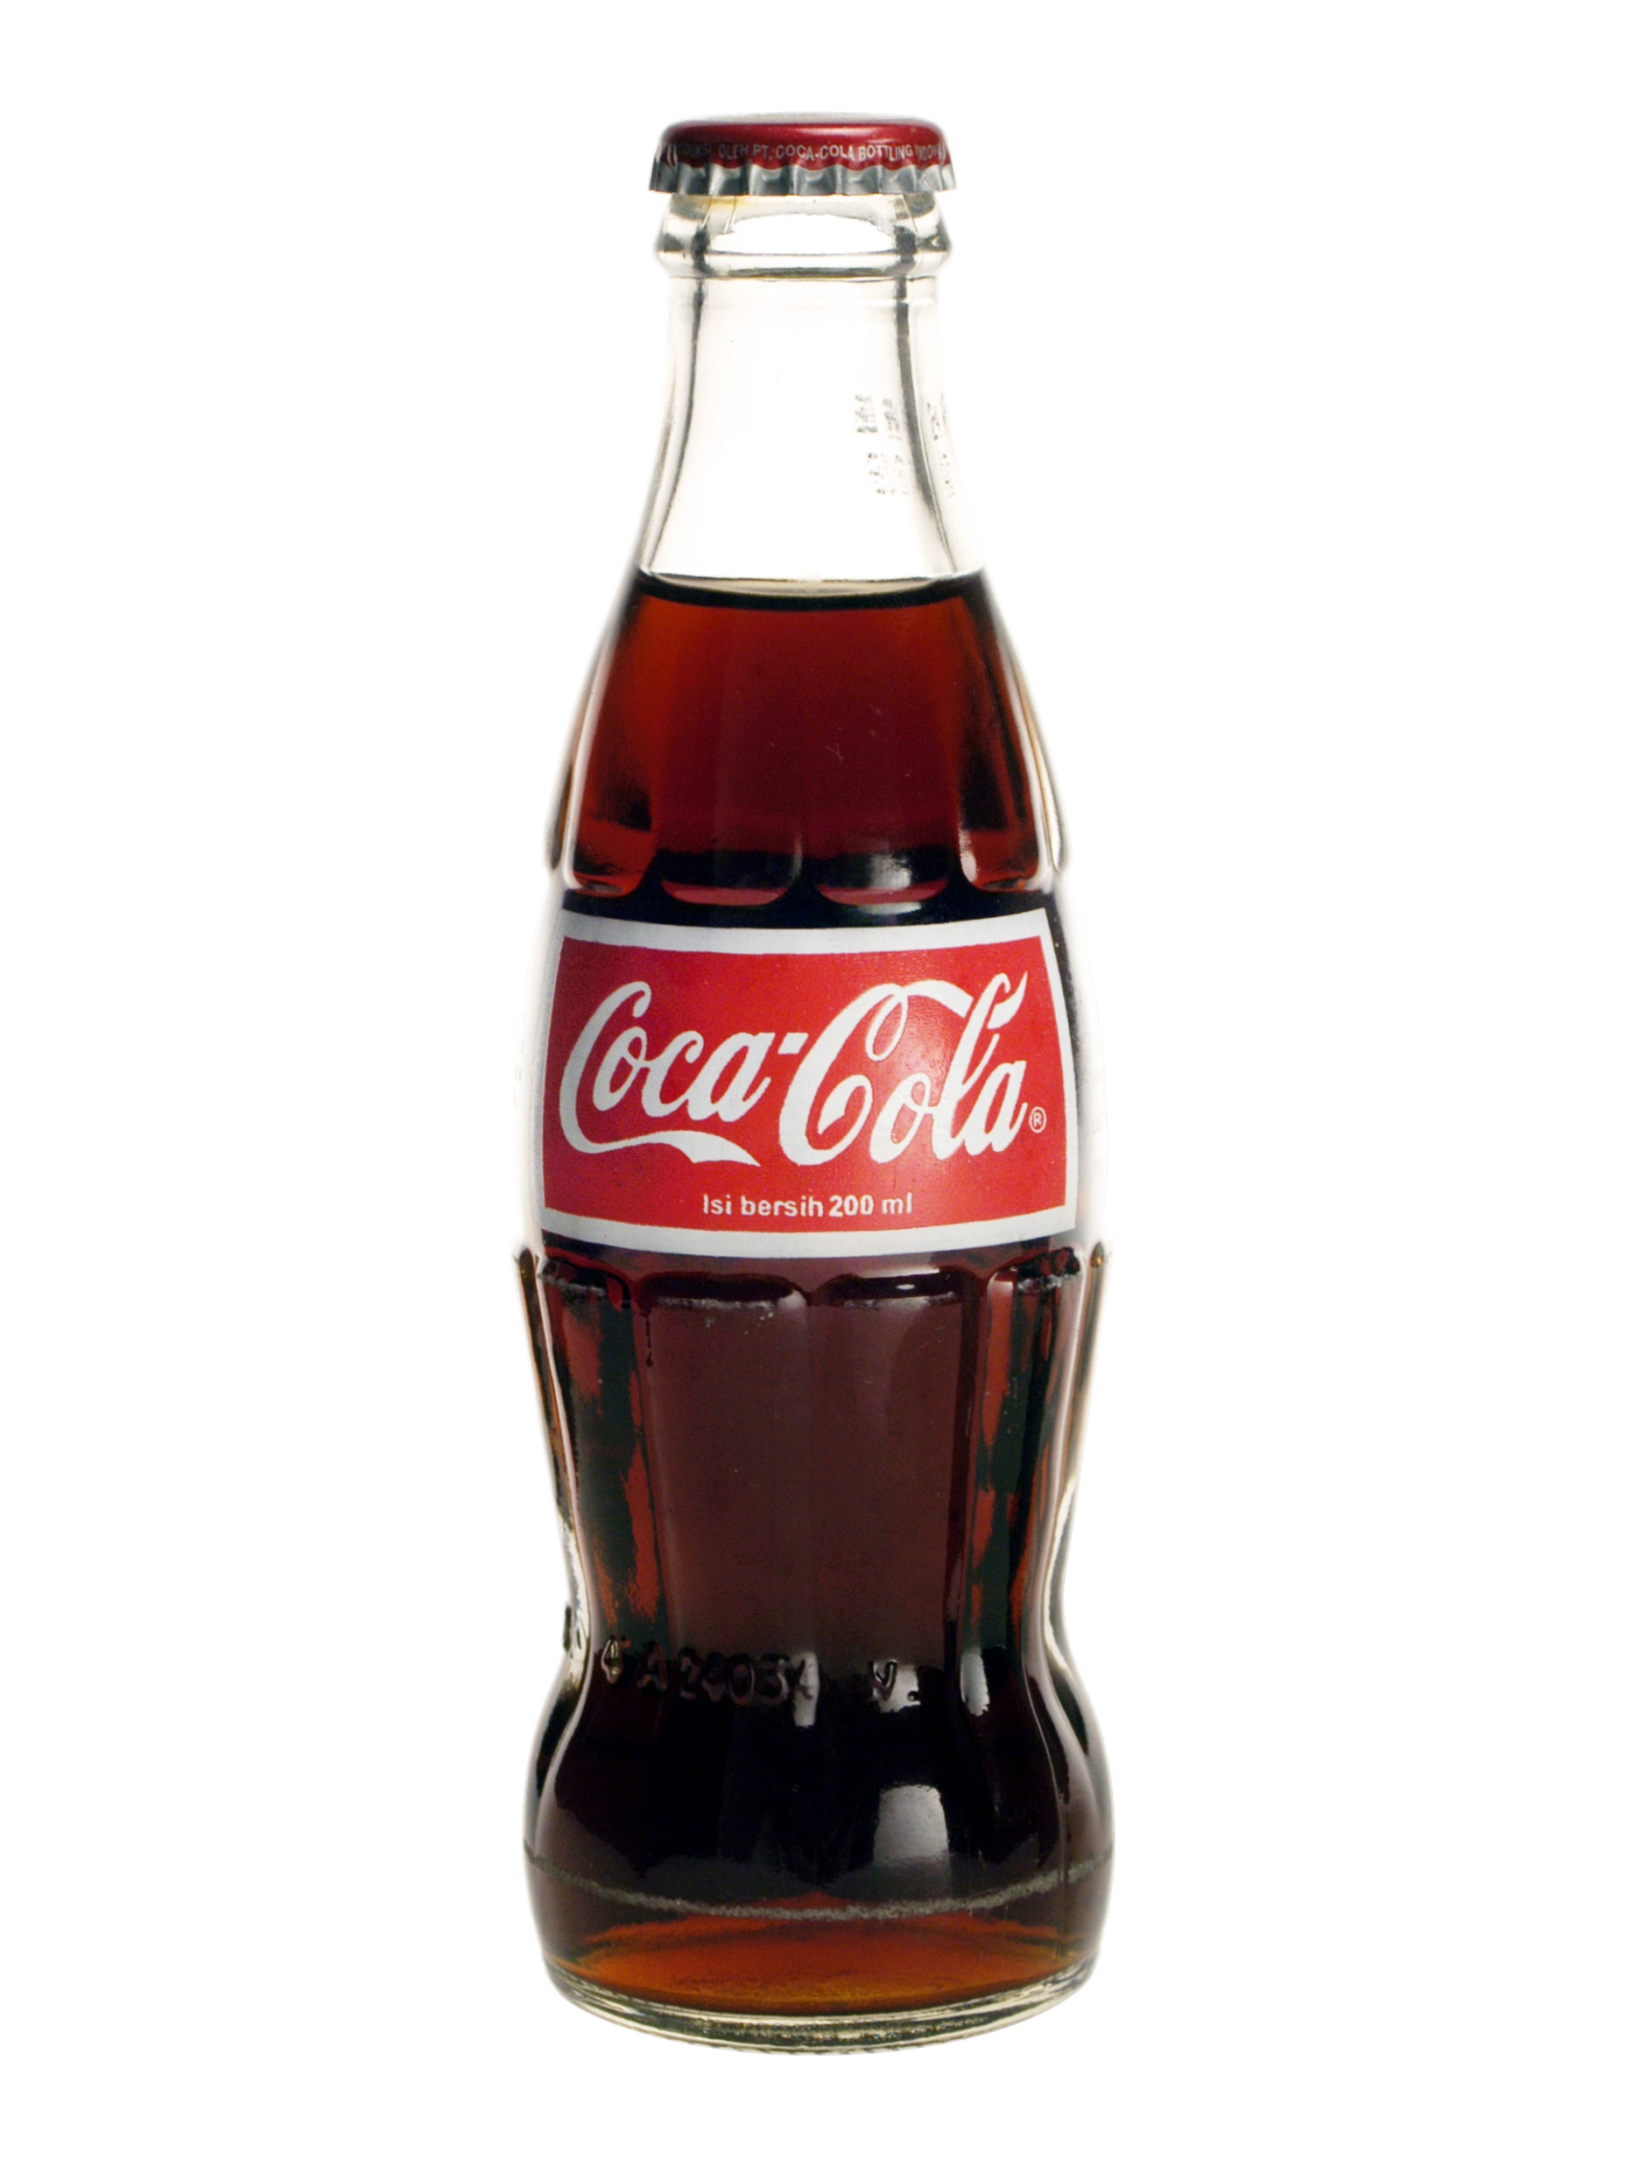
Assets | Liabilities and Owners' Equity
Current assets | Current liabilities
Long-term investments | Long-term debt
Property, plant, and equipment | Stockholders’ equity
Intangible assets
Other assets
Assets used in operation but lacks physical substance
Patents
Trademark or
Tradename
Franchise
*Goodwill
Reported at book value or carrying value (net of accumulated amortization) for limited life and at cost for unlimited life intangible (subject to impairment test).
Lectures + MCQs @ farhatlectures.com ➔ Free Trial

Slide 13
Balance Sheet
December 31, 20X5
Assets
Intangible Assets
 | Goodwill |  |  |  |  | $ 200,000
 | Trademark |  |  |  |  | $ 154,000
 | Franchise |  |  |  |  | 35,000
 |  |  |  |  |  | 389,000
 | Less Accumulated Amortization |  |  |  |  | 100,000
 | Property. Plant and Equipment Net |  |  |  |  | 289,000
Note:
Goodwill is assessed for impairment at least annually at the reporting unit, or more frequently if events or circumstances occur that would more likely than not reduce the fair value of a reporting unit below its carrying value level. The Company performs its annual assessment of goodwill for impairment in the fourth quarter of each fiscal year, typically through a qualitative assessment. Indicators of impairment include: (i) macroeconomic conditions, (ii) industry and market conditions etc.
Intangible assets are amortized on a straight line basis over their respective estimated useful lives ranging from one to twenty years.
Lectures + MCQs @ farhatlectures.com ➔ Free Trial

Slide 14
Assets | Liabilities and Owners' Equity
Current assets | Current liabilities
Long-term investments | Long-term debt
Property, plant, and equipment | Stockholders’ equity
Intangible assets
Other assets
Catch all category. Vary in practice
Long term prepaid
Long term receivable (management intend)
Lectures + MCQs @ farhatlectures.com ➔ Free Trial

