Slide 1


What is a Classified Balance Sheet?
A classified balance sheet is a financial statement that presents a company's assets, liabilities, and equity in a detailed and organized manner, categorizing these elements into various groups to provide a clear picture of the company's financial health.
Lectures + MCQs @ farhatlectures.com ➔ Free Trial

Slide 2

Asset Section
The classifications typically include:
Current Assets: Assets that are expected to be converted into cash or used up within one year. Examples include:
  Cash and cash equivalents
  Accounts receivable
  Inventory
  Prepaid expenses
Non-current Assets (Long-term Assets): Assets that are expected to provide economic benefits beyond one year.
  Property, plant, and equipment (PP&E)
  Intangible assets (like patents and trademarks)
  Long-term investments
Lectures + MCQs @ farhatlectures.com ➔ Free Trial

Slide 3

Liability Section
Current Liabilities: Obligations that are due within one year. Examples include:
  Accounts payable
  Short-term loans
  Accrued expenses
  Unearned revenue
Non-current Liabilities (Long-term Liabilities): Obligations that are due after one year. Examples include:
  Long-term debt
  Pension liabilities
Lectures + MCQs @ farhatlectures.com ➔ Free Trial

Slide 4

Equity
Equity represents the owners' residual interest in the assets of the company after deducting liabilities. Examples include:
  Common stock
  Additional paid-in capital
  Retained earnings
  Treasury stock (if any)
Lectures + MCQs @ farhatlectures.com ➔ Free Trial

Slide 5
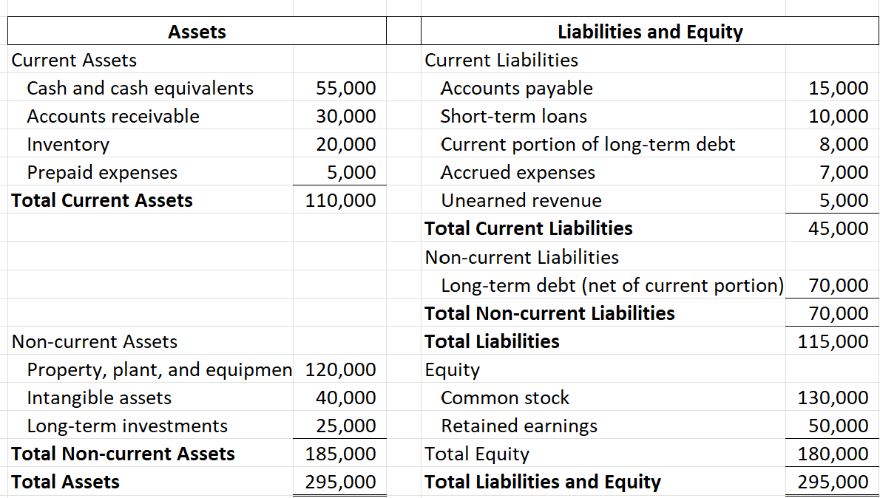
Classified Balance Sheet
Lectures + MCQs @ farhatlectures.com ➔ Free Trial

Slide 6
MCQ from Farhatlecftures.com
LMN Ltd. has a total long-term debt of $100,000, out of which $10,000 is due within the next year. How should this debt be classified on a classified balance sheet?
a) $100,000 under Current Liabilities
b) $90,000 under Non-current Liabilities and $10,000 under Current Liabilities
c) $10,000 under Non-current Liabilities and $90,000 under Current Liabilities
d) $100,000 under Non-current Liabilities
Answer: b) $90,000 under Non-current Liabilities and $10,000 under Current Liabilities
Explanation:
Choice a is incorrect because it incorrectly classifies the entire amount as a current liability.
Choice b is correct because $90,000 of the debt is due after one year (non-current) and $10,000 is due within the next year (current).
Choice c is incorrect because it reverses the classifications of current and non-current portions.
Choice d is incorrect because it does not recognize the current portion of the long-term debt
Lectures + MCQs @ farhatlectures.com ➔ Free Trial

