Slide 2
Prerequisite:
Prerequisite:
  Present Value of Annuity and Single payment
  Future Value of Annuity and Single payment
Advanced Vesrion

Slide 3


Deferred Annuity: Definition
A deferred annuity is an annuity where the payments (or receipts) begin after a specified delay.
For example, if we have a time frame marked as years 0, 1, 2, 3, etc., a deferred annuity might start its payments at year 4, 5, 6, and so on.
No payments occur during the first few years (the deferral period).
Lectures + MCQs @ farhatlectures.com ➔ Free Trial

Slide 4
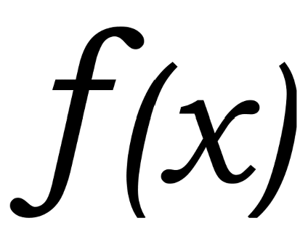
Deferred Annuity Computation
The process to compute the value of a deferred annuity depends on whether you are calculating the future value or the present value:
Future Value (FV):
  For a deferred annuity, the future value calculation is the same as that of a regular annuity.
  You calculate the FV for the payment period directly without needing adjustments for the deferral period.
Present Value (PV):
  For a deferred annuity, calculating the present value requires a two-step process:
    Compute the present value of the annuity at the future start date.
    Discount this present value back to today’s value as a single amount.
Lectures + MCQs @ farhatlectures.com ➔ Free Trial

Slide 5
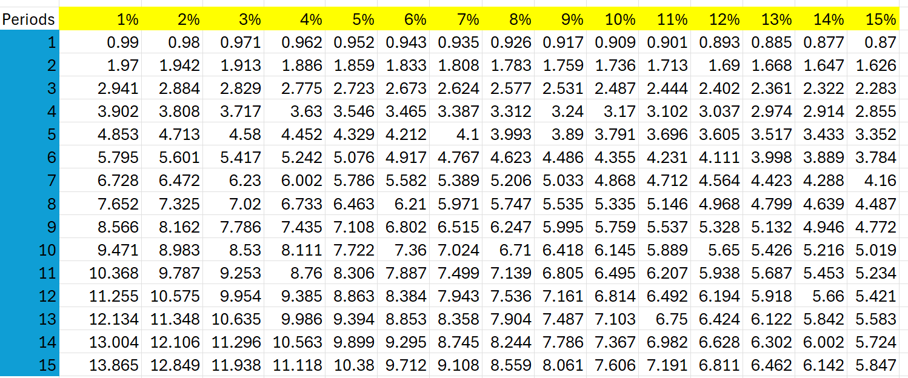
Example Problem: Deferred Annuity PV
How much should you pay today for an investment that will provide six annual payments of $5,000, starting five years from now, if the interest rate is 8%?
Step 1: Find the PV of the annuity at the future start date.
Payments start in year 5 and last for six years (years 5, 6, 7, 8, 9, and 10).
Treat this as a regular annuity:
  N=6 (number of payments),
  i=8% (interest rate),
  The present value factor for an annuity from the table (N = 6, i = 8%) is 4.6229.
PV at year 4​=5000×4.6229=23,114
Lectures + MCQs @ farhatlectures.com ➔ Free Trial

Slide 6
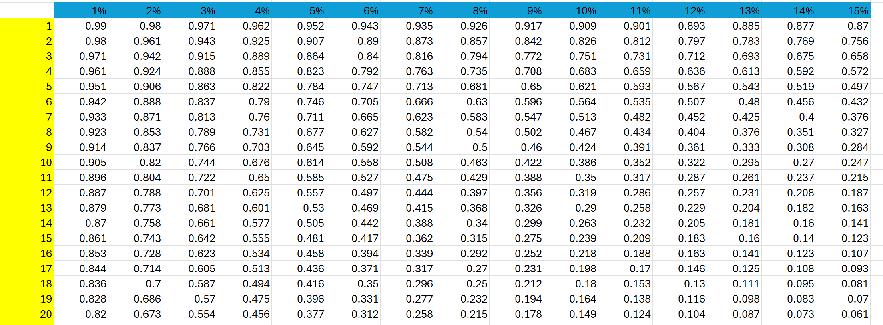
Example Problem: Deferred Annuity PV
Step 2: Discount the PV at year 4 back to today’s value.
Now, discount $23,114 (a single payment) back to year 0:
  N=4 (deferral period),
  i=8%
  The present value factor for a single amount from the table (N = 4, i = 8%) is 0.7350.
Calculation:
PVtoday=23,114×0.7350=16,989.15
Thus, the present value of this deferred annuity today is $16,989.15.
Lectures + MCQs @ farhatlectures.com ➔ Free Trial

Slide 7
Deferred Annuity Alternative Method
You can also solve this problem by treating the deferred annuity as a 10-year annuity and subtracting the first four years.
Compute the present value of a 10-year annuity:
  N=10,
  i=8%
  Factor = 6.7101.
PV10 years=5000×6.7101=33,550.50
2. Subtract the present value of the first 4 years (which are not part of the deferred payments):
N=4
i=8
Factor = 3.3121.
PV4 years​=5000×3.3121=16,560.50
Subtract:
PV deferred=PV10 years−PV4 years=33,550.50−16,560.50=16,990
This method also gives approximately $16,990.
Or 6.7101 - 3.3121 = 3.398.
5,000 x 3.398 = 16,990
Lectures + MCQs @ farhatlectures.com ➔ Free Trial

