Slide 1
Prerequisite

Slide 2

Intro
Welcome to this session on valuing long-term debt, specifically bonds. In this example, we will practice applying the time value of money, focusing on: Bonds
Prerequisite: PV of Single payment and PV of annuity
Application of the TMV
Present Value of a Single Payment
Present Value of an Annuity
The beauty of bond valuation is that it incorporates both concepts, allowing you to develop a deep understanding of the time value of money
Lectures + MCQs @ farhatlectures.com ➔ Free Trial

Slide 3
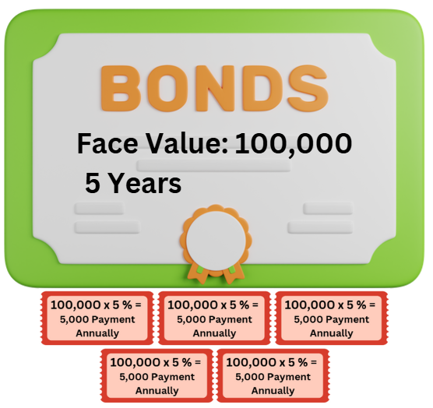
Bonds Basics
A bond typically consists of two main components:
  Periodic Interest Payments (Annuity): Payments made at regular intervals (e.g., annually, semi-annually).
  Face Value (Single Payment): The amount paid back to the bondholder at maturity.
  For this example:
Bond Details:
  Face Value: $100,000
  Term: 5 years
  Coupon Rate: 5% (interest paid annually)
  Market Rate: 6% (discount rate)
The market rate of 6% is critical, as it reflects the return investors expect based on market conditions.
Since the bond's coupon rate (5%) is lower than the market rate, the bond will sell at a discount.
Lectures + MCQs @ farhatlectures.com ➔ Free Trial

Slide 4
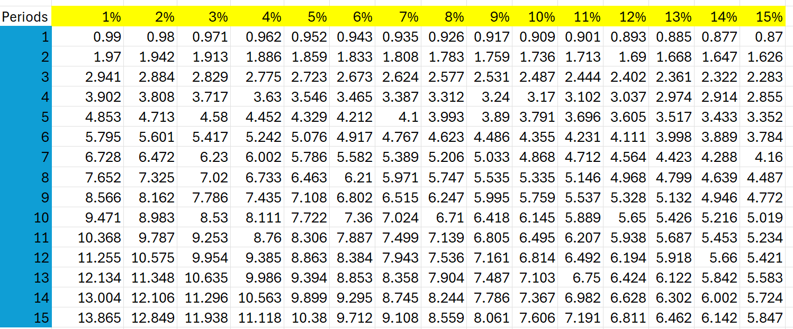
Step 1: Calculate the Present Value of Interest Payments (Annuity)
The bond pays interest annually:
Interest Payment: $100,000 × 5% = $5,000 annually
Periods (N): 5 years
Market Rate (I): 6%
Using the Present Value of an Annuity Table for N=5 and I=6% we find the factor: 4.2124.
Present Value of Interest Payments=5,000× 4.2124=21,062
Lectures + MCQs @ farhatlectures.com ➔ Free Trial

Slide 5
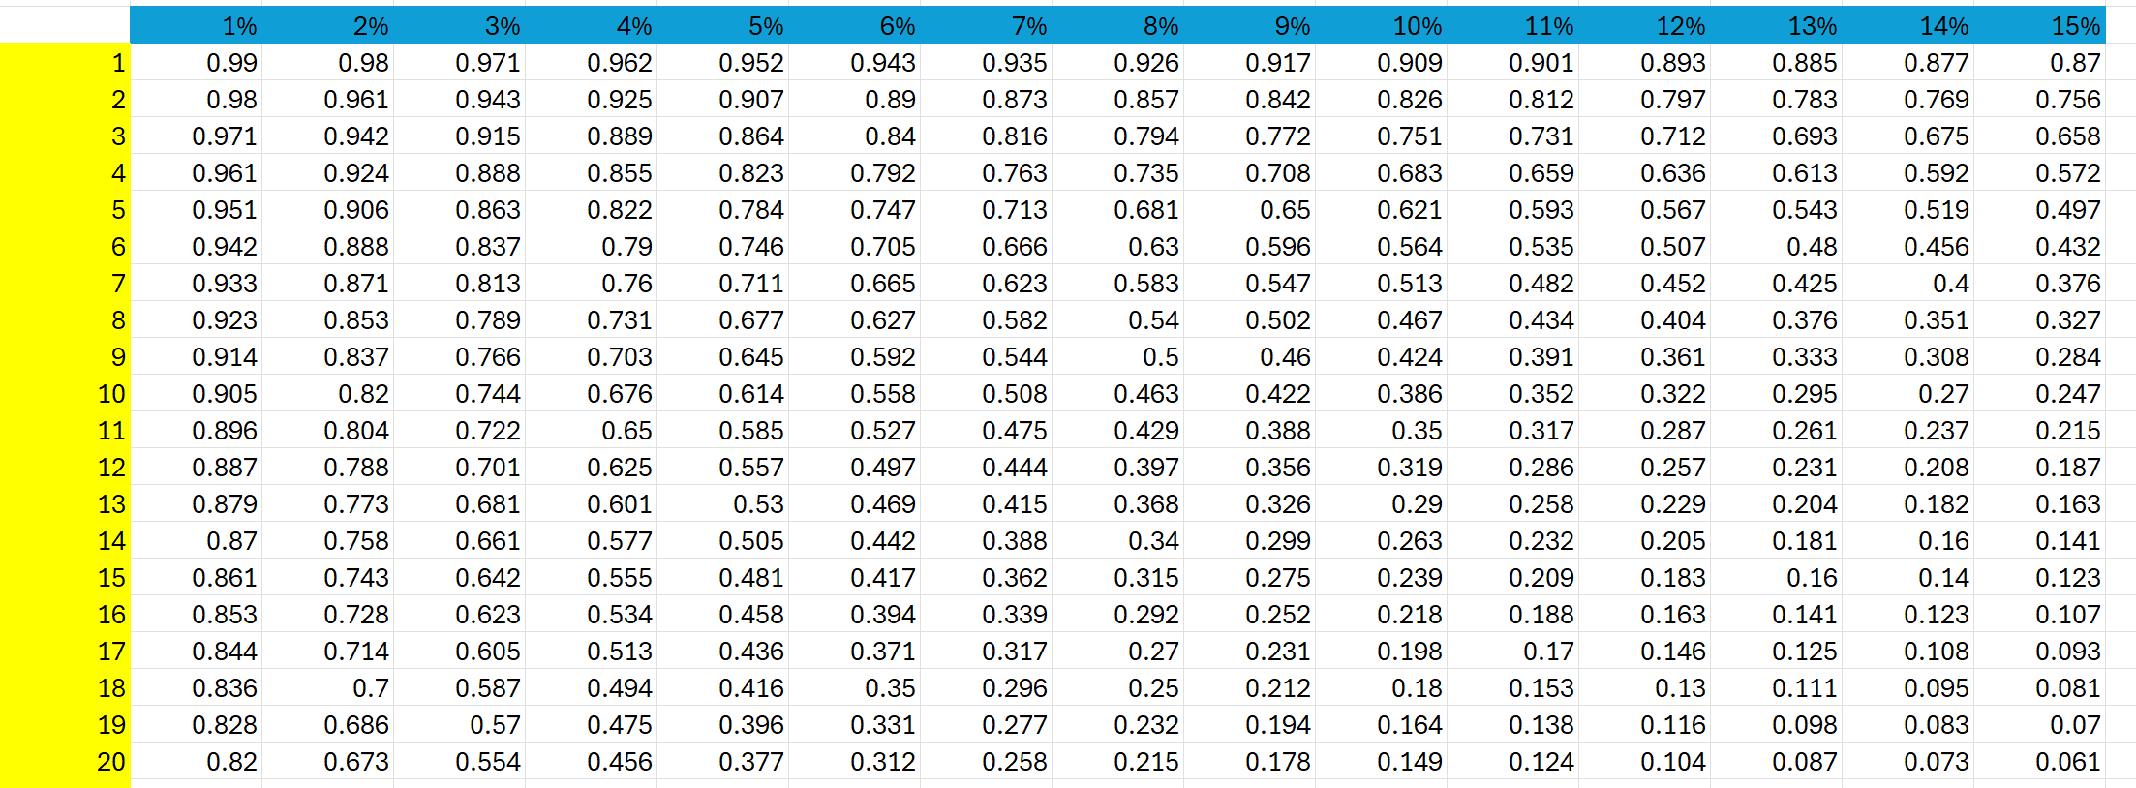
Step 2: Calculate the Present Value of the Face Value (Single Payment)
At the end of 5 years, the investor will receive $100,000. To find its present value:
Face Value: $100,000
Periods (N): 5
Market Rate (I): 6%
Using the Present Value of a Single Payment Table for N=5 and I=6%, we find the factor: 0.7473.
Present Value of Face Value=100,000×0.7473=74,730
Lectures + MCQs @ farhatlectures.com ➔ Free Trial

Slide 6
Step 3: Determine the Bond Price
The bond price is the sum of the present value of the interest payments and the face value:
Bond Price=21,062+74,730=95,792
Lectures + MCQs @ farhatlectures.com ➔ Free Trial

Slide 7
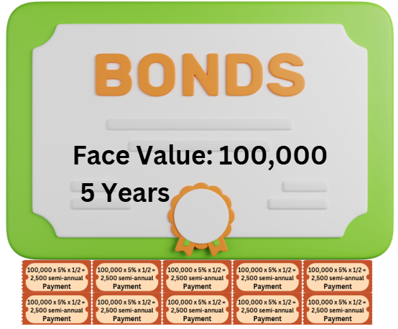
Semi-Annual Adjustment
If the bond pays interest semi-annually, several adjustments are required:
Interest Payment: Halved
  $5,000 ÷ 2 = $2,500
Number of Periods: Doubled
  N=5×2=10
Market Rate Per Period: Halved
  I=6%÷2=3%
Using the updated factors:
Present Value of Interest Payments:
  Factor (Annuity Table, N=10,I=3%) 8.5302
  2,500×8.5302=21,325.500
Present Value of Face Value:
  Factor (Single Payment Table, N=10,I=3%): 0.7441
  100,000×0.7441=74,410
New Bond Price:
Bond Price (Semi-Annual)=21,325.50+74,410=95,735.50
Lectures + MCQs @ farhatlectures.com ➔ Free Trial

