Slide 1

Introduction to the Future Value of an Annuity
The future value (FV) of an annuity refers to the value of periodic payments or receipts, compounded over time at a specific interest rate.
Annuity Definition: A series of equal payments made or received at regular intervals (e.g., monthly mortgage payments, annual investments).
Prerequisite: Understanding the future value of a single amount and the concepts of simple vs. compound interest.
Lectures + MCQs @ farhatlectures.com ➔ Free Trial

Slide 2

Practical Application of Future Value of Annuities
Personal Finance
  Retirement Planning
  Savings Account
Lectures + MCQs @ farhatlectures.com ➔ Free Trial

Slide 3

2 Types of Annuities
Ordinary Annuity:
  Payments occur at the end of each period.
  Example: Investing $10,000 at the end of each year for five years at a 10% interest rate.
  FV formula involves compounding payments over fewer periods as they are made later in the cycle.
Annuity Due:
  Payments occur at the beginning of each period.
  Example: Same $10,000 investment starting at the beginning of each year.
  Results in a higher future value because payments earn interest sooner.
  Conversion: Multiply the FV of an ordinary annuity by (1+interest rate).
Lectures + MCQs @ farhatlectures.com ➔ Free Trial

Slide 4
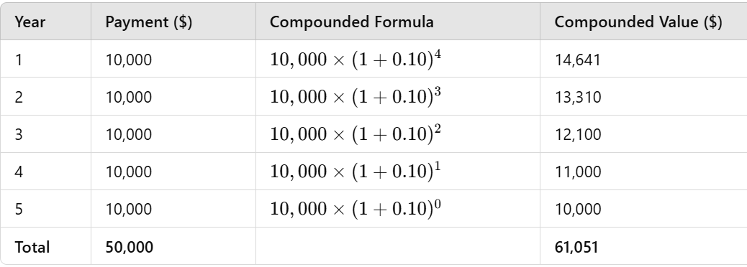
Future Value of an Ordinary Annuity
  Periodic payments starting a year from now: $10,000
  Interest Rate: 10%
  Periods: 5 years
Calculation:
  For each payment, calculate its compounded value at the end of the term.
Lectures + MCQs @ farhatlectures.com ➔ Free Trial

Slide 5

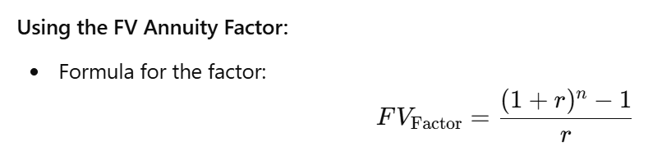
Future Value of an Ordinary Annuity
  Periodic payments starting a year from now: $10,000
  Interest Rate: 10%
  Periods: 5 years
  Use the formula
  FV=6.1051×10,000=61,051
Lectures + MCQs @ farhatlectures.com ➔ Free Trial

Slide 6
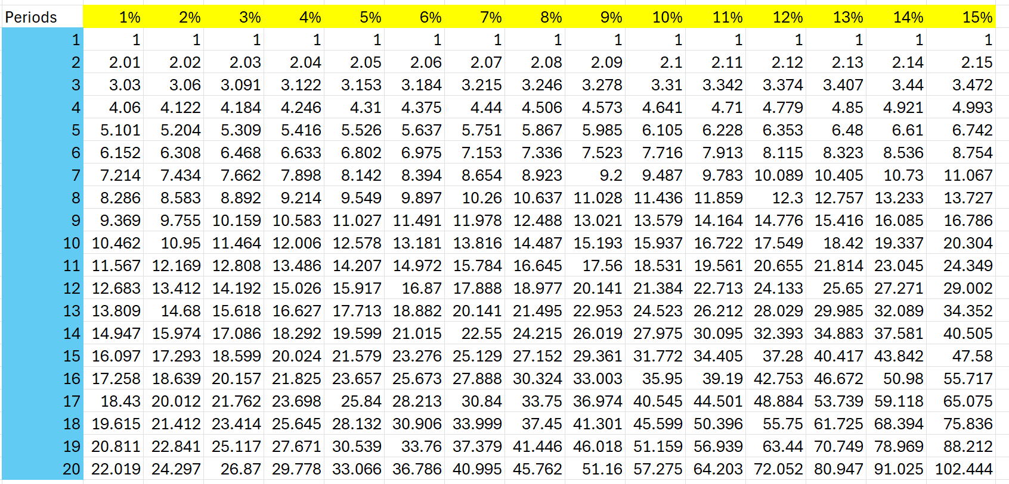
Future Value of Ordinary Annuity Table
  FV=6.1051×10,000=61,051
Lectures + MCQs @ farhatlectures.com ➔ Free Trial

Slide 7
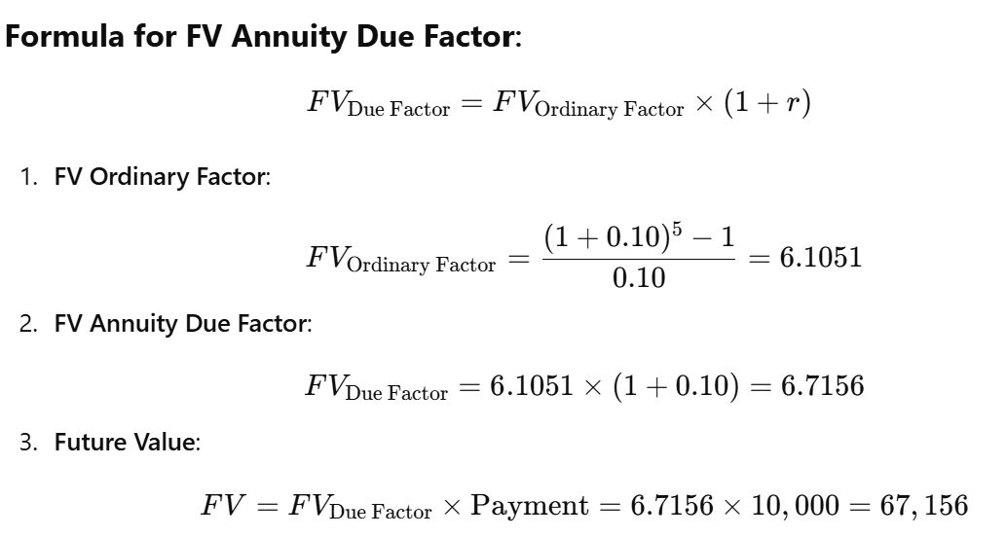
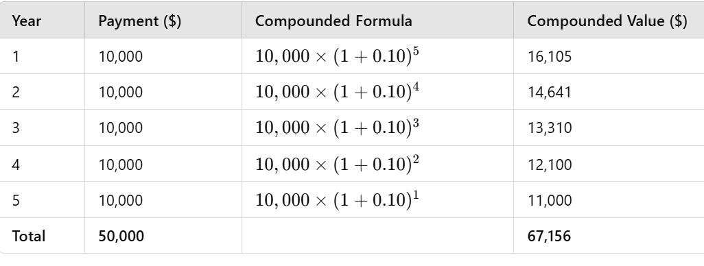
Future Value Annuity Due
  Periodic payments starting now: $10,000
  Interest Rate: 10%
  Periods: 5 years
Lectures + MCQs @ farhatlectures.com ➔ Free Trial

Slide 8
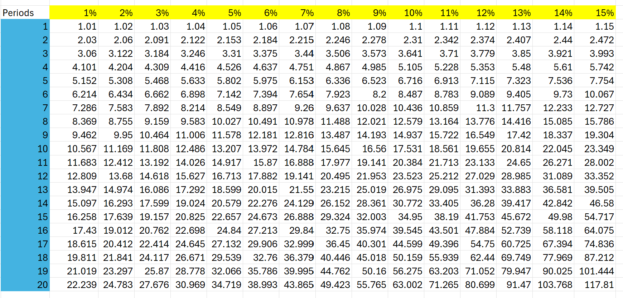
Future Value of Annuity Due Table
10,000 x 6.716 =67,160
Lectures + MCQs @ farhatlectures.com ➔ Free Trial

Slide 9
Another Example
Saving $4,000 Annually
Say you plan to deposit $4,000 at the end of each year for three years into an account earning 8% annual interest. You also have $7,000 saved today. How much will you have after three years?
Your current $7,000 earns 8% for three years:
  $7,000 × (1.08³) = $8,818
Your first $4,000 deposit grows for two years:
  $4,000 × (1.08²) = $4,665
Your second $4,000 grows for one year:
  $4,000 × (1.08¹) = $4,320
Your third $4,000 doesn’t grow since it’s deposited at the end of year three.
Lectures + MCQs @ farhatlectures.com ➔ Free Trial

Slide 10
Adding It All Up
When you total these amounts, here's what you get:
$8,818 (from $7,000 today)
$4,665 (from the first $4,000 deposit)
$4,320 (from the second $4,000 deposit)
$4,000 (from the final $4,000 deposit)
Your grand total after three years? $21,803.
Lectures + MCQs @ farhatlectures.com ➔ Free Trial

Slide 11
Future Value Example
You plan to deposit $100 in one year, $200 in two years, and $300 in three years.
Interest rate: 7% annually.
How much will you have in three years? How about in five years if you stop depositing?
First, Calculate Future Value After 3 Years
The first $100 earns interest for two years:
  $100 × (1.07²) = $114.49
The second $200 earns interest for one year:
  $200 × (1.07¹) = $214
The final $300 earns no interest since it's deposited at year three.
Adding these gives a total of $628.49.
Then, Grow It to 5 Years
After three years, you have $628.49.
Let it sit for another two years, compounding at 7%.
$628.49 × (1.07²) = $719.56.
Lectures + MCQs @ farhatlectures.com ➔ Free Trial

Slide 12
MCQ from Farhatlectures.com
In an ordinary annuity, which payment earns the most interest?
a) The first payment
b) The last payment
c) All payments earn the same interest
d) The middle payment
Correct Answer: a) The first payment
Explanation:
Correct: Choice a is correct because the first payment compounds over the most periods, earning the most interest.
Incorrect:
  Choice b is incorrect because the last payment earns no interest.
  Choice c is incorrect because interest earned depends on the time left to compound.
  Choice d is incorrect because the middle payment earns less than the first.
Lectures + MCQs @ farhatlectures.com ➔ Free Trial

