Slide 1
Intro
Welcome to This Session on the Future and Present Value of a Single Amount
In this session, we will cover the future value (FV) and present value (PV) of a single amount. Before proceeding, please ensure you've reviewed the prior recording on the time value of money, specifically covering simple interest and compound interest, as these concepts are essential for understanding today's topic.
This material is crucial for accounting and finance students and is covered extensively in:
The CPA Exam (FAR Section)
Intermediate Accounting
Finance Courses

Slide 2


Uses of Future Value
Retirement Planning
A person plans to retire in 15 years and wants to know how much their investment will grow if they invest $10,000 today in an account earning an annual interest rate of 8%.
Education Savings for a Child
Parents want to save for their child’s college tuition. They invest $5,000 today in an account that earns 6% annually.
How much will it be worth in 15 years?
Business Equipment Purchase
A company plans to buy new machinery for $100,000 in five years.
They decide to invest $75,000 today in an account earning 5% annual interest.
Will the investment cover the cost of the equipment?
Lectures + MCQs @ farhatlectures.com ➔ Free Trial

Slide 3

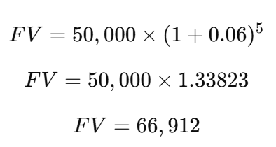
Understanding Future Value (FV)
The future value represents how much an investment made today will grow over a specified period at a particular interest rate.
Example 1: Future Value of $50,000 Invested Today
Present Value (PV): $50,000
Interest Rate (i): 6% (compounded annually)
Number of Periods (n): 5 years
Formula for Future Value:
Using the formula:
Lectures + MCQs @ farhatlectures.com ➔ Free Trial

Slide 4

Prove it!
You can also prove this step-by-step:
Year 1: $50,000 × 1.06 = $53,000
Year 2: $53,000 × 1.06 = $56,180
Year 3: $56,180 × 1.06 = $59,551
Year 4: $59,551 × 1.06 = $63,124
Year 5: $63,124 × 1.06 = $66,912
Lectures + MCQs @ farhatlectures.com ➔ Free Trial

Slide 5
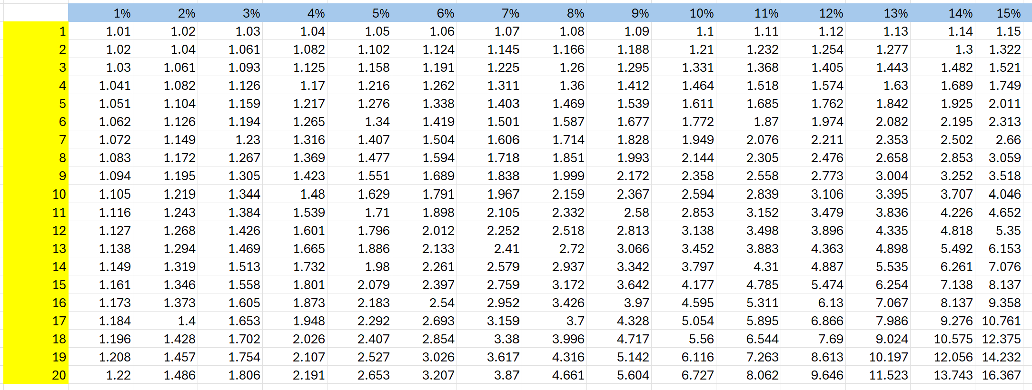
Table: Future Value of $1. FV of $1
50,000 x 1.338 = 66,912 rounding
Or use finance Calculator
Lectures + MCQs @ farhatlectures.com ➔ Free Trial

Slide 6
Compounding Interest
The future value represents how much an investment made today will grow over a specified period at a particular interest rate.
Example 1: Future Value of $50,000 Invested Today
Present Value (PV): $50,000
Interest Rate (i): 6% (Semi annually)
Number of Periods (n): 5 years
Formula for Future Value:
i= 3%
N = 10 periods
50,000 x 1.344 = 67,200
Versus 66,912
Difference 288
Lectures + MCQs @ farhatlectures.com ➔ Free Trial

Slide 7

Practical Uses of Present Value
1. Deciding on an Investment Opportunity
A company is considering an investment opportunity that promises a payout of $100,000 five years from now. The company's required rate of return is 8%. The company wants to determine if investing today makes sense.
2. Car Loan Evaluation
A car dealership offers a financing deal where you can either:
Pay $25,000 in cash today.
Finance the car and pay $27,000 in two years with 5% interest.
3. Retirement Savings
An individual wants to have $1,000,000 saved by retirement in 15 years. They plan to invest a lump sum today in an account earning 7% annually. They need to calculate how much to invest now.
House Purchase Decision
A family is considering buying a house for $300,000 in 10 years. They have an option to invest in a fund earning 6% annually to save for it. How much should they invest now?
Lectures + MCQs @ farhatlectures.com ➔ Free Trial

Slide 8
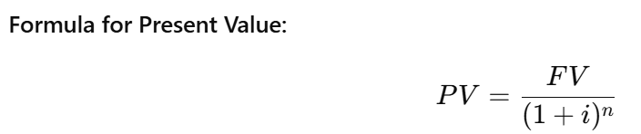
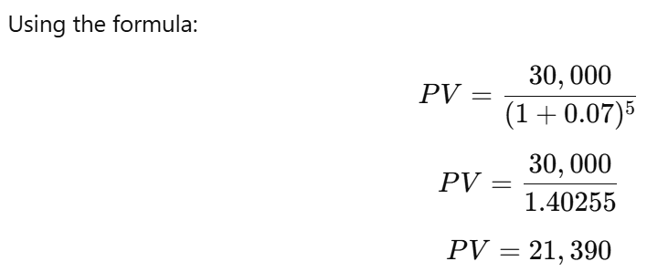
Present Value (PV)
The present value tells us how much we need to invest today to achieve a specific future value at a given interest rate over a specified period.
Example 2: Present Value of $30,000 Needed in 5 Years
Future Value (FV): $30,000
Interest Rate (i): 7% (compounded annually)
Number of Periods (n): 5 years
Lectures + MCQs @ farhatlectures.com ➔ Free Trial

Slide 9
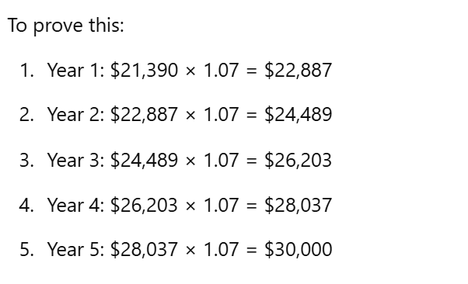
Prove it!
Lectures + MCQs @ farhatlectures.com ➔ Free Trial

Slide 10
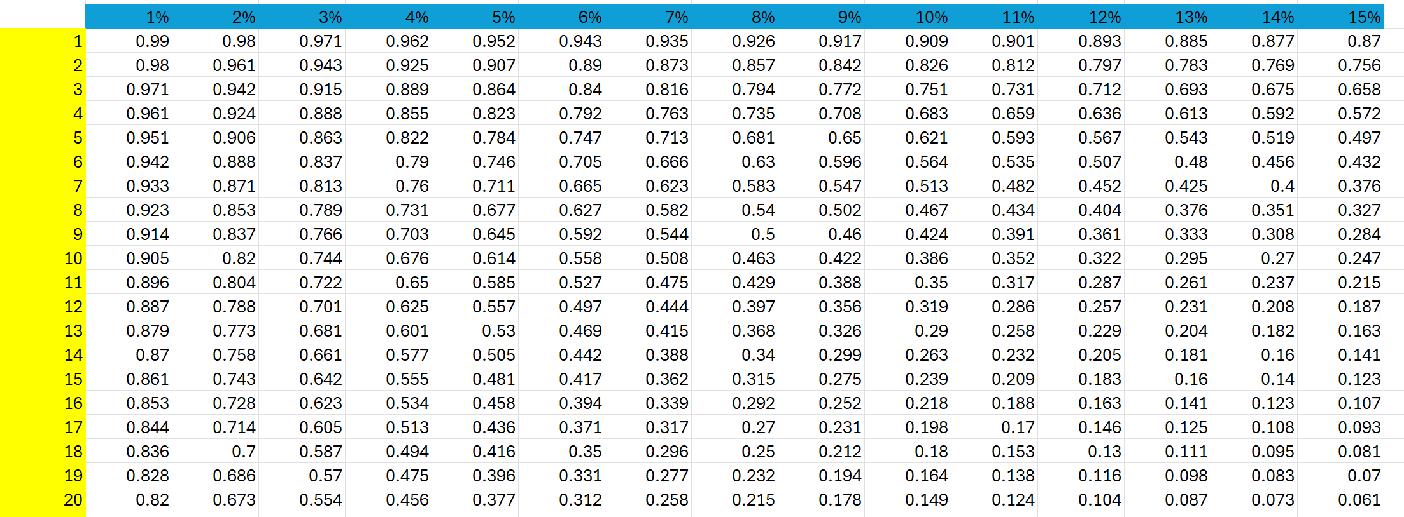
Table: Present Value of $1. FV of $1
30,000 x .713 = 21,390
Or Use finance calculator
Same Concept for compounding.
Lectures + MCQs @ farhatlectures.com ➔ Free Trial

Slide 11
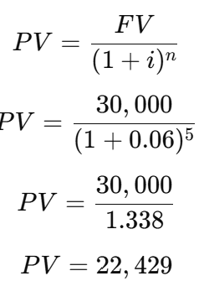
Example: Comparing Present Value with Annual and Semiannual Compounding
You plan to purchase a car in 5 years for $30,000. You want to know how much to invest today if the interest rate is 6% annually and 6% compounded semiannually.
Annual Compounding
Given:
Future Value (FV): $30,000
Interest Rate (i): 6% annually
Number of Periods (n): 5 years
Lectures + MCQs @ farhatlectures.com ➔ Free Trial

Slide 12
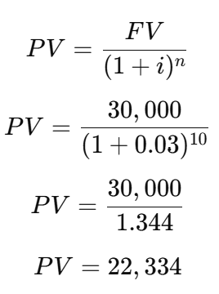
Semiannual Compounding
Adjustments:
Semiannual compounding means:
Interest rate per period (i) = 6%÷2=3%
Number of periods (n) = 5×2=10
Comparison
Annual Compounding PV: $22,429
Semiannual Compounding PV: $22,334
Semiannual compounding results in a lower present value because the interest is compounded more frequently, allowing your money to grow faster.
This means you need to invest less upfront to reach your $30,000 goal in 5 years.
Lectures + MCQs @ farhatlectures.com ➔ Free Trial

Slide 13

Finding the Interest Rate or Period
Sometimes, you're tasked with finding the interest rate or number of periods.
Example 4: How Long to Accumulate $50,000 from $33,330 at 7%?
Present Value (PV): $33,330
Future Value (FV): $50,000
Interest Rate (i): 7%
Using the PV method.
Find 0.666 in the PV table under i=7%
This corresponds to n=6
Lectures + MCQs @ farhatlectures.com ➔ Free Trial

Slide 14
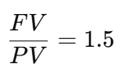
Finding the Interest Rate or Period
Sometimes, you're tasked with finding the interest rate or number of periods.
Example 4: How Long to Accumulate $50,000 from $33,330 at 7%?
Present Value (PV): $33,330
Future Value (FV): $50,000
Interest Rate (i): 7%
Alternatively, use the FV method:
Find 1.5 in the FV table under i=7%
which also corresponds to n=6
Lectures + MCQs @ farhatlectures.com ➔ Free Trial

Slide 15
MCQ from Farhatlectures.com
The time value of money concept implies which of the following?
a) A dollar received today is worth less than a dollar received in the future.
b) A dollar received today is worth the same as a dollar received in the future.
c) A dollar received today is worth more than a dollar received in the future.
d) The time value of money applies only to savings accounts.
Answer: c
Explanation:
Choice c is correct because a dollar received today can be invested to earn interest, making it worth more than a dollar received in the future.
Choice a is incorrect because a dollar today is worth more, not less.
Choice b is incorrect because the value changes over time due to the earning potential of money.
Choice d is incorrect because the time value of moneye
Lectures + MCQs @ farhatlectures.com ➔ Free Trial

