Slide 1


What is the Objective of Financial Reporting?
The main idea behind financial reporting is to give useful financial information to people outside (external users) the company.
  This helps them make informed decisions.
  But who are these people?
  Target Audience: The main targets are investors and creditors. Why?
The process is called financial reporting/accounting or just reporting in the real world.
Lectures + MCQs @ farhatlectures.com ➔ Free Trial

Slide 2
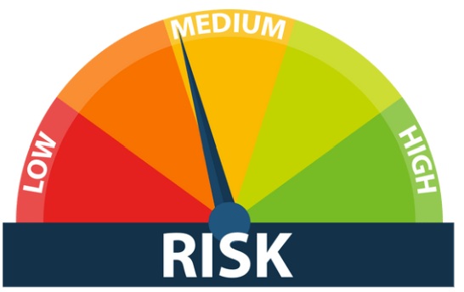
Why focus on investors and creditors?
They're the ones risking their money.
Investors buy stock, hoping the company grows and their investment increases in value.
Creditors, like banks, lend money and want to be sure they'll get paid back.
  Because they're taking a risk, they need clear and reliable information to evaluate the company's ability to generate future cash flows.
Investors and creditors are keenly interested in a company's cash receipts and disbursements, as well as the certainty of these cash flows.
These insights enable them to gauge the company's performance and stability.
Lectures + MCQs @ farhatlectures.com ➔ Free Trial

Slide 3

How Helpful is this information?
The information we provide should help them evaluate:
  How much cash they might receive (if they're investors) or be paid (if they're creditors).
  When they'll receive that cash (timing is everything!).
  How certain they can be about getting that cash (risk matters).
Of course, there are other users too, like government agencies, employees, and customers.
Lectures + MCQs @ farhatlectures.com ➔ Free Trial

Slide 4

How Financial Information is Conveyed?
So, how do we get this information to investors and creditors?
Through financial statements and disclosures.
  Financial Statements: These are the formal reports that summarize a company's financial performance and position.
  The main ones are:
    Income Statement: Shows if the company made a profit or loss.
    Balance Sheet: Shows what the company owns (assets) and owes (liabilities), and the difference between them (equity).
    Statement of Cash Flows: Shows how cash came in and went out of the company.
    Statement of Shareholders' Equity: Shows how the owners' stake in the company has changed over time.
    Disclosures: These are extra details that explain the numbers in the financial statements.
      They might include information about accounting policies, risks, or major events.
Lectures + MCQs @ farhatlectures.com ➔ Free Trial

Slide 5

The Role of Financial Reporting in the Capital Market
Why is financial reporting so crucial?
It's the backbone of the capital market.
The Capital Market Explained: Think of “Wall Street”.
It's a place where people with money (investors) meet companies that need money.
  But the capital market isn't just Wall Street.
It's any place where companies can find funding.
Maybe it's a local bank, venture capitalist, or even friends and family.
From Garage to Global: Remember Microsoft? It started in a garage.
To grow, they needed money.
They went to the capital market, got investors, and the rest is history.
Lectures + MCQs @ farhatlectures.com ➔ Free Trial

Slide 6

Financial Reporting's Critical Role
So, where does financial reporting fit in?
The Oil in the Machine: Financial reporting provides the reliable information that investors need to make informed decisions.
The Primary Communication Channel: For many investors, financial statements are the only way they learn about a company.
  They don't get to talk to the CEO or visit the headquarters.
  They rely on the numbers.
Call to Action for Future CPAs: As a future CPA, you'll be responsible for preparing these financial statements.
It's a big responsibility because people rely on them to make important financial decisions.
Take your job seriously.
Lectures + MCQs @ farhatlectures.com ➔ Free Trial

Slide 7
MCQ from Farhatlectures.com
Financial accounting assists users of accounting information to perform all of the following, except for:
Buying, selling, and holding ordinary shares and bonds.
Making investment decisions
Determining the creditworthiness of the company to decide whether to grant it a loan or not.
Planning and controlling the company’s daily operations.
Lectures + MCQs @ farhatlectures.com ➔ Free Trial

