Slide 1
Income Statement
Purpose and Limitations
Elements of Income Statement
Unusual and infrequent gains and losses
Discontinued operations

Slide 2
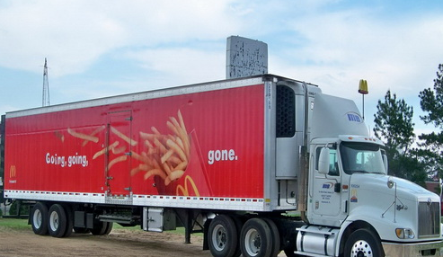
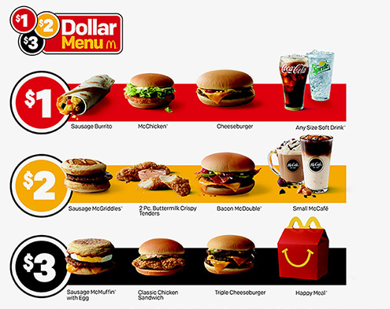
1) Revenues
  Increases in assets and/or reduction in liabilities as a results of delivering/producing goods and services from the companies ongoing central or major operation.
  Example: Sales revenues, consulting revenues, tuition revenues
2) Expenses
  Decreases in assets and/or increase in liabilities as a results of incurring cost to run the business central/major operations. Example. COGS, Rent, Depreciation, salary , delivery etc.
3) Gains
  Increases in assets and/or reduction in liabilities as a results from peripheral or incidental transactions of an entity.
  Example sale of PPE, sale of Investment write-off of assets
4) Losses
  Decreases in assets and/or increase in liabilities from peripheral or incidental transactions of an entity.
  Example sale of PPE, sale of Investment

Slide 3
Adam Company
Income Statement
For the Year Ended December 31, 20X4
Sales revenue |  |  |  | $ 120,000
Cost of goods sold |  |  |  | 75,300
Gross profit |  |  |  | 44,700
Operating Expenses
Selling expenses
 | Sales commissions | $ 7,980
 | Depreciation of sales equipment | 6,480
 | Delivery expense | 2,690 | $ 17,150
Administrative expenses
 | Officers’ salaries | 4,900
 | Depreciation of office furniture and equipment | 3,960 | 8,860 | 26,010
Income from operations |  |  |  | 18,690
Other Revenues and Gains
 | Gain on a sale of warehouse |  |  | 10,000
 | Rent revenue |  |  | 17,230
 |  |  |  | 45,920
Other Expenses and Losses
 | Loss from sale of investment |  |  | 5,000
 | Interest expense |  |  | 1,860
Income before income tax |  |  |  | 39,060
 | Income tax |  |  | 8,203
Net income |  |  |  | $ 30,857
Earnings per share |  |  |  | $ 0.76
1) Revenues
  Increases in assets and/or reduction in liabilities as a results of delivering/producing goods and services from the companies ongoing central or major operation.
  Example: Sales revenues, consulting revenues, tuition revenues
2) Expenses
  Decreases in assets and/or increase in liabilities as a results of incurring cost to run the business central/major operations. Example. COGS, Rent, Depreciation, salary , delivery etc.
3) Gains
  Increases in assets and/or reduction in liabilities as a results from peripheral or incidental transactions of an entity.
  Example sale of PPE, sale of Investment write-off of assets
4) Losses
  Decreases in assets and/or increase in liabilities from peripheral or incidental transactions of an entity.
  Example sale of PPE, sale of Investment

Slide 4
Adam Company
Income Statement
For the Year Ended December 31, 20X4
Sales revenue |  |  |  | $ 120,000
Cost of goods sold |  |  |  | 75,300
Gross profit |  |  |  | 44,700
Operating Expenses
Selling expenses
 | Sales commissions | $ 7,980
 | Depreciation of sales equipment | 6,480
 | Delivery expense | 2,690 | $ 17,150
Administrative expenses
 | Officers’ salaries | 4,900
 | Depreciation of office furniture and equipment | 3,960 | 8,860 | 26,010
Income from operations |  |  |  | 18,690
Other Revenues and Gains
 | Gain on sale of warehouse |  |  | 10,000
 | Rent revenue |  |  | 17,230
 |  |  |  | 45,920
Other Expenses and Losses
 | Loss on sale of Equipment |  |  | 5,000
 | Interest expense |  |  | 1,860
Income before income tax |  |  |  | 39,060
 | Income tax |  |  | 8,203
Net income |  |  |  | $ 30,857
Earnings per share |  |  |  | $ 0.76
P. BRIDE COMPANY
Income Statement
For the Year Ended December 31, 20X4
Revenues
Net sales |  |  |  | $ 120,000
Gain on sale of warehouse |  |  |  | $ 10,000
Rental revenue |  |  |  | 17,230
 | Total revenues |  |  | 147,230
Expenses
Cost of goods sold |  |  |  | 75,300
Selling expenses |  |  |  | 17,150
Loss on sale of investment |  |  |  | 5,000
Administrative expenses |  |  |  | 8,860
Interest expense |  |  |  | 1,860
 | Total expenses |  |  | 108,170
Income before income tax |  |  |  | 39,060
Income tax |  |  |  | 8,203
 | Net income |  |  | $ 30,857
Earnings per share |  |  |  | $ 0.76

