Slide 1
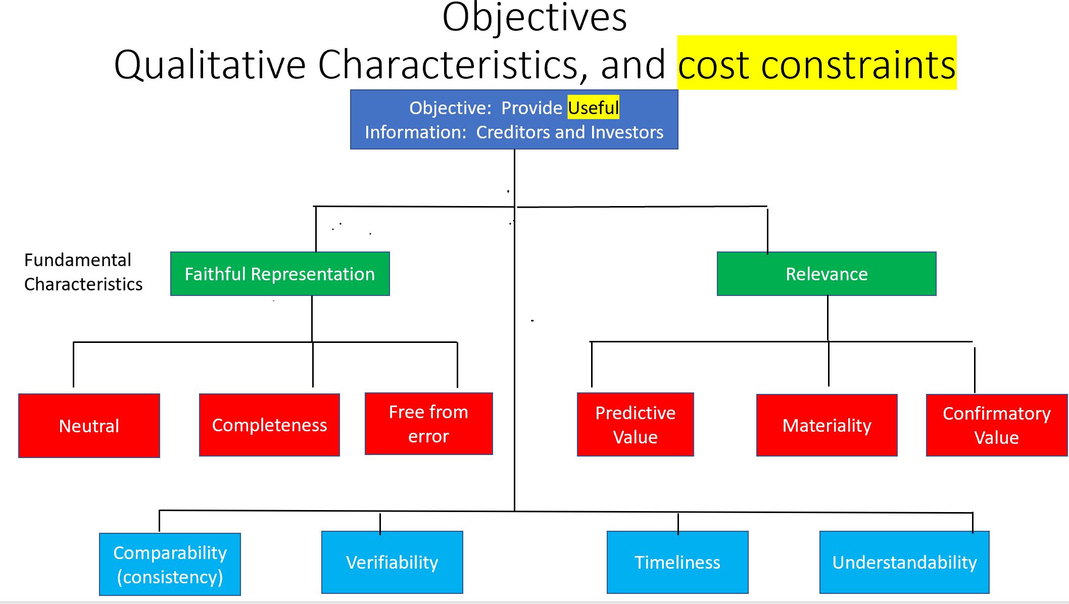

Slide 2
Statements of Financial Accounting Concepts (SFACs)
Objectives
  Qualitative Characteristics, and cost constraints
Elements of financial statements
Recognition measurement and disclosure concepts
  Assumptions and principles
Elements of Financial Statements:
  Assets, liabilities, equity
  investment by owners, distribution to owners,
  revenues, expenses, gains, losses
  comprehensive income
Student or CPA Candidate?
www.farhatlectures.com

Slide 3
Assets
  Resources (owned or controlled) that provide current and future benefit as a result of past transactions. Example:
Liabilities (obligation or debt)
  Requires future sacrifice of asset to settle a current liability that was generated in the past. Example
Equity (or net assets or net worth)
  Difference between assets and liabilities. Residual interest in the assets of an entity after settling the liabilities.
Investments by owners:
  Transfer of assets from investors/owners/shareholders to the entity.
  Increases the equity of the company
Distributions to owners
  Withdrawals of assets by the investors/owners/shareholders
  Decreases the equity of the company.
Student or CPA Candidate?
www.farhatlectures.com

Slide 4
Revenues
  Increases in assets and/or reduction in liabilities as a results of delivering/producing goods and services from the companies ongoing central or major operation.
  Increases equity. Example
Expenses
  Decreases in assets and/or increase in liabilities as a results of incurring cost to run the business central/major operations. Example
Gains
  Increases in assets and/or reduction in liabilities as a results from peripheral or incidental transactions of an entity. Example
Losses
  Decreases I assets and/or increase in liabilities from peripheral or incidental transactions of an entity. Example
Comprehensive income
  Net income + any changes in equity other than owner sources (investment by owners’ and distribution to owner’s).
  Example:
  unrealized gains or losses on hedge/derivative financial instruments and
  foreign currency transaction gains or losses.
Student or CPA Candidate?
www.farhatlectures.com

Slide 5
Which of the following accounts is recorded in the statement of financial position/balance sheet?
Equity
Expenses
Gains
Revenues
Student or CPA Candidate?
www.farhatlectures.com

