Slide 1
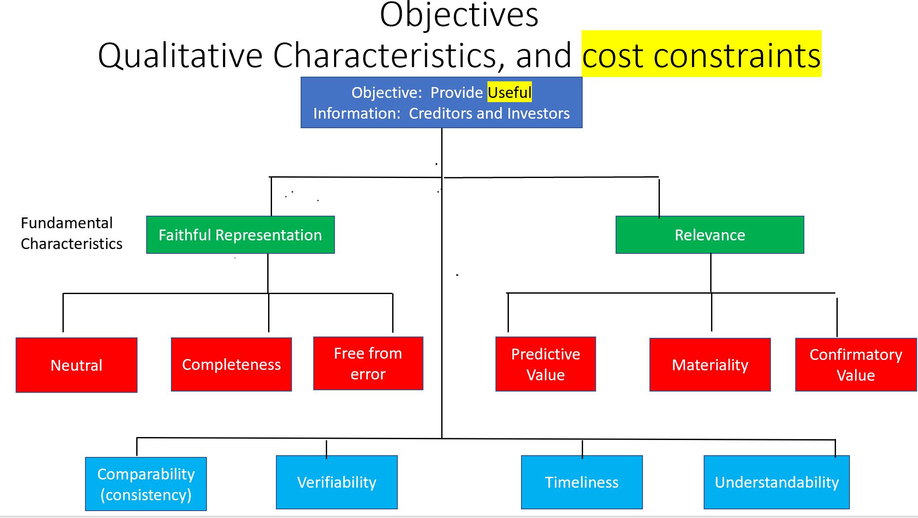

Slide 2
Statements of Financial Accounting Concepts (SFACs)
Objectives
  Qualitative Characteristics, and cost constraints
Elements of Financial Statements:
  Assets, liabilities, equity
  investment by owners, distribution to owners,
  revenues, expenses, gains, losses
  comprehensive income
  Assumptions and principles
Student or CPA Candidate?
www.farhatlectures.com

Slide 3
GAAP Assumptions
1) Economic Entity:
  Activities by the owners of business are kept separately form the activities of the business itself
  Account for business assets and owners’ assets separately.
2) Going Concern
  Assume to be in business for the the foreseeable future
  No liquidation value
  Assets. Depreciation
  Survive the owners’ life
3) Periodicity assumption
  Life of the company can be separated into artificial time period (Monthly, Quarterly Yearly, etc.
  Financial statement. Adjustment. Closing
4) Monetary unit
  Use monetary unit to measure transactions: U.S. dollar in the USA
  Account for inflation if needed.

Slide 4
GAAP Principles
1) Revenue Recognition
2) Expense Recognition
  When do we record something on the financial statements
3) Measurement
  What $ do we assign to that element of financial statements.
  Historical Cost. Net Realizable Value. Replacement Cost Current Cost. PV of future cash flows and fair value (more on that later)
4) Full disclosures
  Include any information (+ FS) that could influence the decision made by external uses
    Parenthetical comments
    Disclosure notes (lawsuits, commitments etc.)
    Supplemental schedule and tables
Student or CPA Candidate?
www.farhatlectures.com

Slide 5
Revenue Recognition
When do we recognize revenue?
  Earnings process is complete or virtually complete
  Collectability is reasonably assured
FASB issued ASU No. 2014-09 (whole chapter)
  recognize revenue when goods or services are transferred to customers for the amount the company expects to be entitled to receive in exchange for those goods or services
Student or CPA Candidate?
www.farhatlectures.com

Slide 6
Expense (matching) Recognition
Expenses follow revenues.
  Record all expense that helped generate revenue for that particular period.
Four approaches:
Based on an exact cause-and-effect relationship
  COGS
By associating an expense with the revenues recognized in a specific time period
  Wages, Utilities, Rent
By a systematic and rational allocation to specific time periods
  Depreciation, amortization
In the period incurred, without regard to related revenue
  Advertising
Student or CPA Candidate?
www.farhatlectures.com

Slide 7
Measurements $
Historical cost (Objective)
  Original transaction value adjusted for depreciation and amortization
  Building – accumulated depreciation
  Assets: what is given in exchange (usually) cash. (initial measurements)
  Liabilities; Cash equivalent received in exchange for assuming the liability.
Net realizable value:
  the amount of cash into which an asset is expected to be converted in the ordinary course of business
  A/R – Uncollectible = Net A/R
Replacement Cost
  Estimated selling price in the ordinary course of business, less reasonably predictable costs of completion, disposal, and transportation (Inventory)
  LCM
Current cost:
  the cost that would be incurred to purchase or reproduce the asset. Used in inflationary times
Present value:
  the current value of future cash flows, calculated by applying the time value of money
  Bonds. ARO. Impairment
Fair value:
  the price that would be received to sell assets or paid to transfer a liability in an orderly transaction between market participants at the measurement date. No fire sale
Student or CPA Candidate?
www.farhatlectures.com

