Slide 1


3 Steps in Analyzing Transactions
1) What happened?
  Do you understand the nature of the transaction?
2) Which accounts (at least two) are effected? And classify them
  Look for the word cash, pay and receive.
  Assets? Liability? Equity ➔ revenues, expenses, common stock or dividend?
3) Determine the directional impact
Lectures + MCQs @ farhatlectures.com ➔ Free Trial

Slide 2
Transaction 1:
Investment by Owner
The accounts involved are:
(1) Cash (asset)
(2) Common Stock (equity)
Adam Farhat invests $40,000 cash to start a corporation named Farhat Lectures.
Lectures + MCQs @ farhatlectures.com ➔ Free Trial
Notes:
21
Let’s look at the identification and recording of business transactions. We can begin by analyzing a transaction where Chas Taylor forms a corporation, named FastForward. Taylor invests thirty thousand dollars cash in exchange for common stock in the new company.
First, we have to identify the assets, liability or equity accounts involved in this transaction. We can see that the cash account will increase by thirty thousand dollars and the common stock account will also increase by thirty thousand dollars.
Let’s see how the books of the company will appear after we record this transaction.

Slide 3
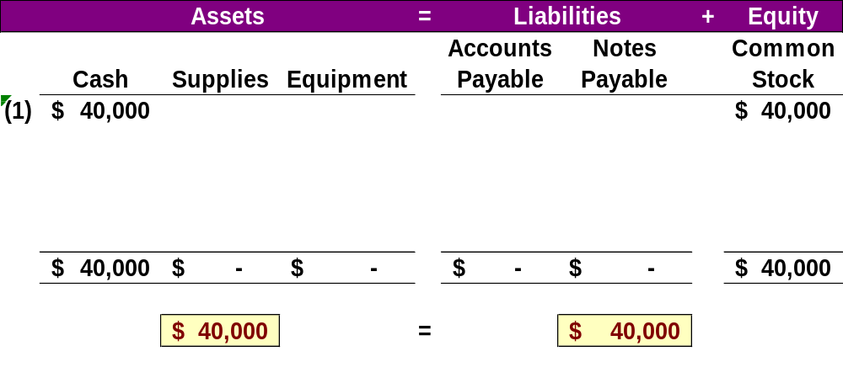
Accounting Equation 1
Adam Farhat invests $40,000 cash to start a corporation named Farhat Lectures (FL).
Lectures + MCQs @ farhatlectures.com ➔ Free Trial
Notes:
21
Here we show the increase in the asset account, cash, and the increase in the equity account, Common Stock, by thirty thousand dollars. Our basic accounting equation is in balance. Assets have a total balance of thirty thousand dollars and liabilities plus equity have a total balance of thirty thousand dollars. Let’ move on to another transaction.

Slide 4
Transaction 2:
Purchase Supplies for Cash
The company purchased supplies, paying $2,200 cash from Office Supplies
The accounts involved are:
(1) Cash (asset)
(2) Supplies (asset)
Lectures + MCQs @ farhatlectures.com ➔ Free Trial
Notes:
25
In this transaction, the company purchases general office supplies by paying two thousand, five hundred dollars cash. The asset account, cash, will decrease by the two thousand, five hundred dollars cash paid. The asset account, supplies, will increase by two thousand, five hundred dollars, the cost of the supplies. In this transaction we are giving up one asset, cash, and receiving another asset, supplies. Let’s look at our books after this transaction is recorded.

Slide 5
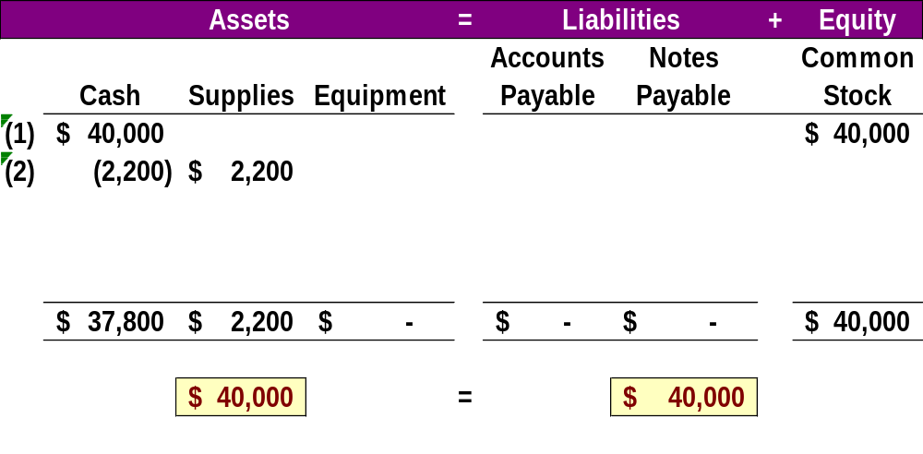
Accounting Equation 2
The company purchased supplies, paying $2,200 cash.
Lectures + MCQs @ farhatlectures.com ➔ Free Trial
Notes:
25
We can see the decrease in cash and the increase in supplies. The total assets are still equal to thirty thousand dollars but are divided between cash and supplies. There is no change on the liabilities plus equity section of our books.

Slide 6
Transaction 3:
Purchase Equipment for Cash
Farhat Lectures purchased equipment for $26,000 cash from IBM.
The accounts involved are:
(1) Cash (asset)
(2) Equipment (asset)
Lectures + MCQs @ farhatlectures.com ➔ Free Trial
Notes:
29
This transaction is similar to the last one we recorded. Here we purchase equipment by paying twenty six thousand dollars cash. The asset account, cash, will decrease by twenty six thousand dollars. The asset account, equipment, will increase by twenty six thousand dollars. Once again, we are exchanging one asset for another. Can you predict what our books will look like after recording this transaction?

Slide 7
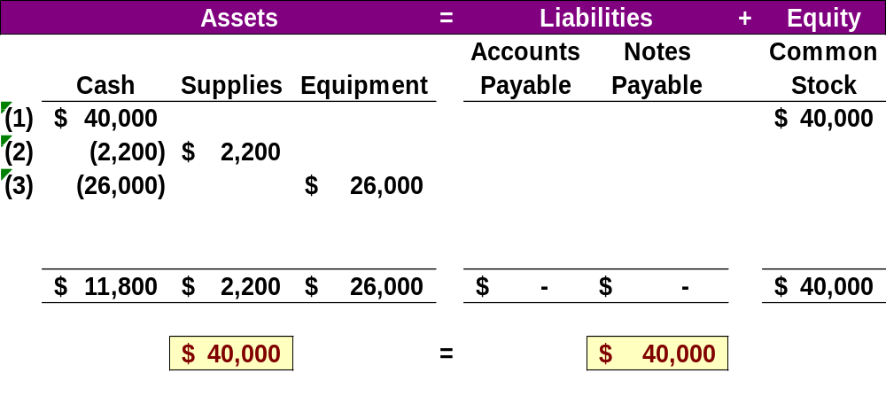
Accounting Equation 3
Farhat Lectures purchased equipment for $26,000 cash from IBM.
Lectures + MCQs @ farhatlectures.com ➔ Free Trial
Notes:
29
Cash is reduced by twenty six thousand dollars and equipment is increased by twenty six thousand dollars. The balance in our cash account is now one thousand five hundred dollars. We have a current balance in supplies of two thousand five hundred dollars, and equipment of twenty six thousand dollars. The three asset accounts total thirty thousand dollars. Once again, there has been no change in the liabilities plus equity side of the equation.

Slide 8
Transaction 4:
Purchase Supplies on Credit
Farhat Lectures purchased additional supplies of $5,100 on credit from Office Supplies
The accounts involved are:
(1) Supplies (asset)
(2) Accounts Payable (liability)
Lectures + MCQs @ farhatlectures.com ➔ Free Trial
Notes:
30
In this transaction, the company purchases supplies seventy one hundred dollars on credit. We do not pay cash, but agree to pay off the account at some point in the future. The asset account, supplies increases by seventy one hundred dollars and the liability account, accounts payable, increases by seventy one hundred dollars as well. Let’s see what our books look like now.

Slide 9
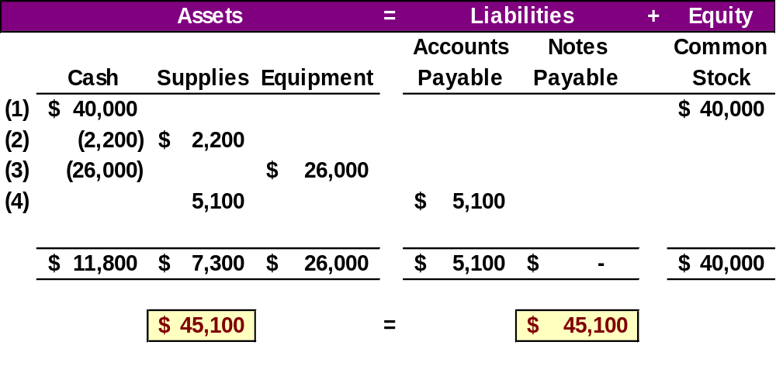
Accounting Equation 4
Farhat Lectures purchased additional supplies of $5,100 on credit from Office Supplies
Lectures + MCQs @ farhatlectures.com ➔ Free Trial
Notes:
30
You can see the balance in the cash, supplies and equipment accounts. The total on the asset side of the equation is thirty seven thousand, one hundred dollars. We acquired the assets without paying cash. If you use a credit card to purchase gas for your car, you receive an asset, gas, and incur an account payable to the credit card company. The balance in the liabilities accounts is now seventy one hundred dollars, and the common stock account balance is still thirty thousand dollars.

Slide 10
Transaction 5:
Provide Services for Cash
Farhat Lectures provided consulting services to a customer and received $4,500 cash right away.
The accounts involved are:
(1) Cash (asset)
(2) Revenues (equity)
Lectures + MCQs @ farhatlectures.com ➔ Free Trial
Notes:
32
The company rendered consulting services to a customer receiving forty two hundred dollars cash in full payment. The asset account, cash, will increase by forty two hundred dollars. The equity account, revenues, will also increase by the same amount. Let’s look at our expanded book balances.

Slide 11
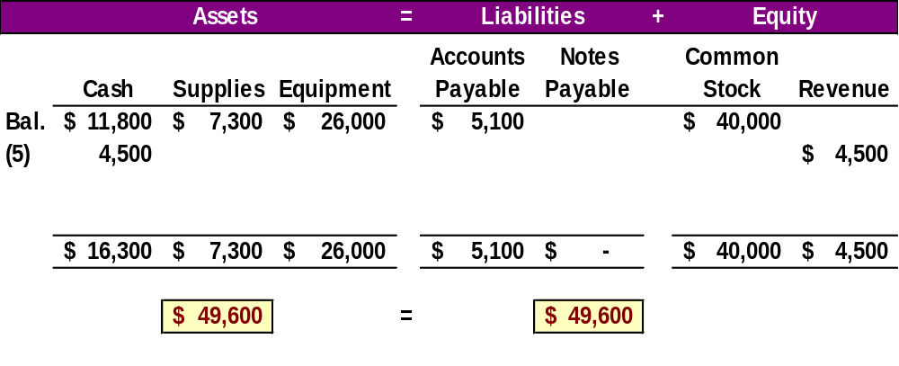
Accounting Equation 5
Farhat Lectures provided consulting services to a customer and received $4,500 cash right away.
Lectures + MCQs @ farhatlectures.com ➔ Free Trial
Notes:
32
You see that our cash account increases by forty two hundred dollars, to a current balance of five thousand seven hundred dollars. Total assets amount to forty one thousand, three hundred dollars. The revenue account also increased by forty two hundred dollars. Recall that from our expanded accounting equation that revenues increase equity and expenses decrease equity. The total of our liabilities plus equity is now forty one thousand, three hundred dollars.

Slide 12
Transactions 6 and 7:
Payment of Expenses in Cash
The accounts involved are:
(1) Cash (asset)
(2) Rent expense (equity)
(3) Salaries expense (equity)
Farhat Lectures paid rent of $1,200 and salaries of $500 to employees.
Lectures + MCQs @ farhatlectures.com ➔ Free Trial
Notes:
The company paid cash rent of $1,000 and cash salaries of $700 to employees. The asset account, cash, decreases by one thousand seven hundred dollars. The equity account, rent expense increases by $1,000 and salaries expense increases by $700. Remember, an increase in an expense account will decrease total equity. Do you think you can get this transaction recorded properly in our books?

Slide 13
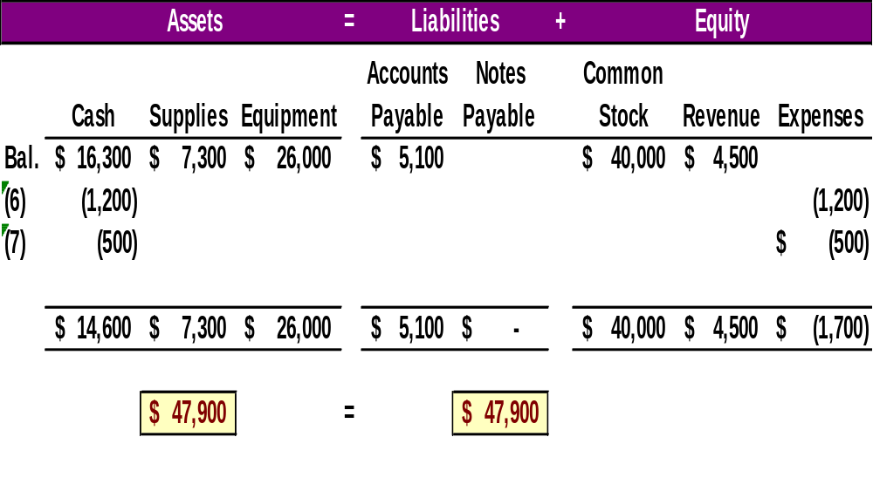
Accounting Equation 6 and 7
Farhat Lectures paid rent of $1,200 and salaries of $500 to employees.
Remember that expenses decrease equity.
Lectures + MCQs @ farhatlectures.com ➔ Free Trial
Notes:
How did you do? You got the decrease in the cash account, but did you remember to show the increase in expenses as a decrease in total equity. Our expanded equation is getting to look more and more complicated. Don’t worry, practice will help you fully understand the recording of these and similar transactions. Our books are still in balance.

Slide 14
Transaction 8:
Provide Services and Facilities for Credit
Farhat Lectures provided consulting services of $1,800 and rented facilities for $200 to a customer on credit.
The accounts involved are:
(1) Accounts receivable (asset)
(2) Consulting Revenues (equity)
(3) Rental Revenue (equity)
Lectures + MCQs @ farhatlectures.com ➔ Free Trial
Notes:
32
The company provided consulting services of $1,600 and rented its test facilities for $300 to a customer. The asset account, Accounts receivable, will increase by $1,900. The equity account, Consulting revenue will increase by $1,600 and the equity account Rental Revenue, will also increase by the $300. Let’s look at our expanded book balances.

Slide 15
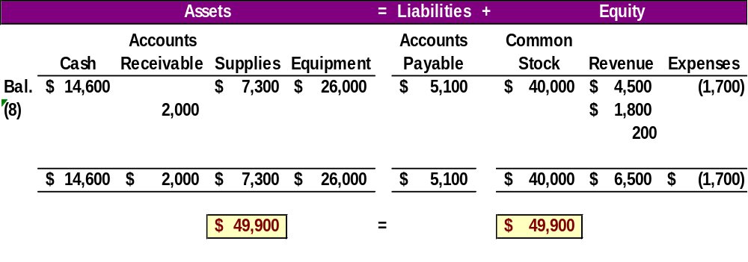
Accounting Equation 8
Farhat Lectures provided consulting services of $1,800 and rented facilities for $200 to a customer on credit.
Lectures + MCQs @ farhatlectures.com ➔ Free Trial
Notes:
Our expanded equation is getting to look more and more complicated. Don’t worry, practice will help you fully understand the recording of these and similar transactions. Our books are still in balance.

Slide 16
Transaction 9:
Receipt of Cash from Accounts Receivable
The accounts involved are:
(1) Cash (asset)
(2) Accounts receivable (asset)
The client in transaction 8 paid $2,000 for consulting services to Farhat Lectures.
Lectures + MCQs @ farhatlectures.com ➔ Free Trial
Notes:
32
The client in transaction 8 pays $1,900 10 days after it is billed for consulting services.

Slide 17
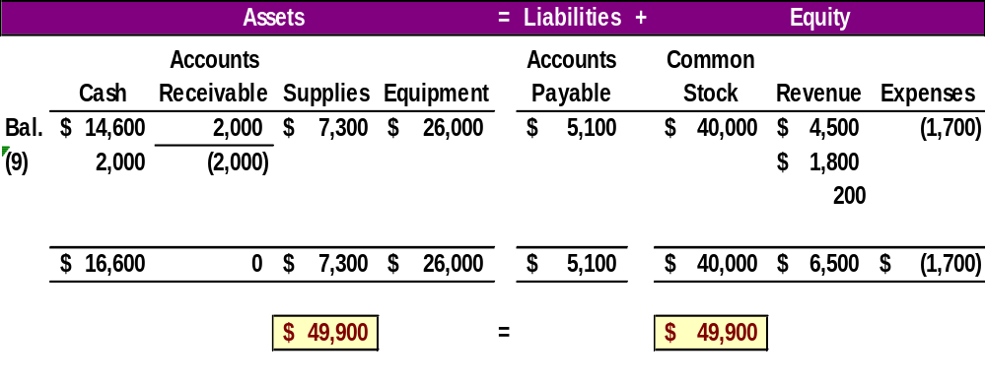
Accounting Equation 9
The client in transaction 8 paid $2,000 for consulting services to Farhat Lectures.
Lectures + MCQs @ farhatlectures.com ➔ Free Trial
Notes:
The client in transaction 8 pays $1,900 10 days after it is billed for consulting services. The total amount of assets remains the same, and liabilities and equity remain the same as well.

Slide 18
Transaction 10:
Payment of Accounts Payable
The accounts involved are:
(1) Cash (asset)
(2) Accounts payable (liability)
Farhat Lectures pays $1,000 as a partial payment for supplies purchased in transaction 4.
Lectures + MCQs @ farhatlectures.com ➔ Free Trial
Notes:
32
FastForward pays $900 as partial payment for its earlier purchase of supplies purchased in transaction 4 leaving $6,200 balance unpaid.

Slide 19
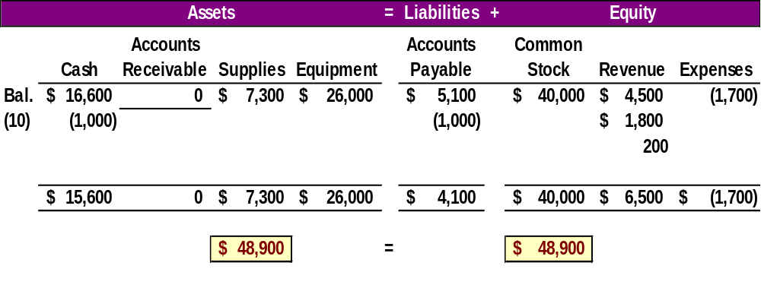
Accounting Equation 10
Farhat Lectures pays $1,000 as a partial payment for supplies purchased in transaction 4.
Lectures + MCQs @ farhatlectures.com ➔ Free Trial
Notes:
FastForward pays $900 as partial payment for its earlier purchase of supplies purchased in transaction 4 leaving $6,200 balance unpaid in its Accounts payable account.

Slide 20
Transaction 11:
Payment of Cash Dividend to Owner
The accounts involved are:
(1) Cash (asset)
(2) Dividends (equity)
Adam Farhat withdraws $500 cash from Farhat Lectures for personal use.
Lectures + MCQs @ farhatlectures.com ➔ Free Trial
Notes:
FastForward pays a $200 cash dividend to its owner (the sole shareholder). The company’s cash account decreased by $200. The equity account, Dividends, increased by $200. Once again, refer back to the expanded accounting equation and you will see that dividends decrease total equity.

Slide 21
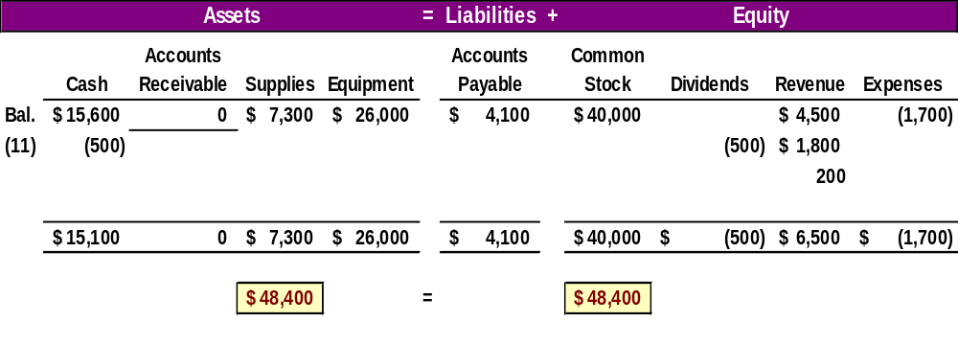
Accounting Equation 11
Adam Farhat withdraws $500 cash from Farhat Lectures for personal use.
Lectures + MCQs @ farhatlectures.com ➔ Free Trial
Notes:
The company’s cash account decreased by $200. The equity account, Dividends, increased by $200.

Slide 22
Summary of Transactions
Assets |  |  |  |  | = Liabilities | + Equity
Transaction No. | Cash | + Accounts Receivable | + Supplies | + Equipment | = Accounts Payable | + Common Stock | - Dividends | + Revenues | - Expenses
(1) | $40,000 |  |  |  | = | $40,000
(2) | - 2,200 |  | + $2,200
Balance | 37,800 |  | + 2,200 |  | = | + 40,000
(3) | - 26,000 |  |  | + $26,000
Balance | 11,800 |  | + 2,200 | + 26,000 |  | + 40,000
(4) |  |  | + 5,100 |  | = + $5,100
Balance | 11,800 |  | + 7,300 | + 26,000 | = 5,100 | + 40,000
(5) | + 4,500 |  |  |  |  |  |  | + $4,500
Balance | 16,300 |  | + 7,300 | + 26,000 | = 5,100 | + 40,000 |  | + 4,500
(6) | - 1,200 |  |  |  |  |  |  |  | - $1,200
Balance | 15,100 |  | + 7,300 | + 26,000 | = 5,100 | + 40,000 |  | + 4,500 | - $1,200
(7) | - 500 |  |  |  |  |  |  |  | - $500
Balance | 14,600 |  | + 7,300 | + 26,000 | = 5,100 | + 40,000 |  | + 4,500 | - 1,700
(8) |  | + $2,000 |  |  |  |  |  | + 2,000
Balance | 14,600 | + $2,000 | + 7,300 | + 26,000 | = 5,100 | + 40,000 |  | + 6,500 | - 1,700
(9) | + 2,000 | - 2,000
Balance | 16,600 | + 0 | + 7,300 | + 26,000 | = 5,100 | + 40,000 |  | + 6,500 | - 1,700
(10) | - 1,000 |  |  |  | - 1,000
Balance | 15,600 | + 0 | + 7,300 | + 26,000 | = 4,100 | + 40,000 |  | + 6,500 | - 1,700
(11) | - 500 |  |  |  |  |  | - $ 500
Balance | $ 15,100 | + $ 0 | + $ 7,300 | + $ 26,000 | = $ 4,100 | + $ 40,000 | - $ 500 | + $ 6,500 | - $ 1,700
Notes:
Exhibit 1.9 shows the effects of all 11 transactions using the accounting equation.

Slide 23
MCQ from Farhatlectures.com
​Purchasing equipment on account (payment to be made in the future) will have what effect on the components of the accounting equation?
Increase in equipment (assets) and a decrease in equity
Increase in equipment (assets) and an increase in equity
Increase in equipment (assets) and an increase in liabilities
Increase in equipment (assets) and a decrease in liabilities
Lectures + MCQs @ farhatlectures.com ➔ Free Trial

